Slide 1
Polygenic Risk Scoring
Peter Sørensen
Center for Quantitative Genetics and Genomics (QGG)

Slide 2
Who Am I?
Senior Scientist - Center for Quantitative Genetics and Genomics (QGG) - Aarhus University (2003-present)
Statistical models and methods for better understanding of genetic architecture and prediction of complex traits and diseases
Implemented some of these methods into an R software package (qgg) that can be used for risk prediction
Senior Scientist - Genomics Plc - Oxford (2016-2020)
Genomics Plc is a company focused on using genomics for drug discovery and precision health in human health care systems
Developed statistical methods and contributed to implementing a computational platform for genetic risk prediction used in Precision Health
Notes:
I am a Senior Scientist at Center for Quantitative Genetics and Genomics at Aarhus University
We have been a key scientific partner in establishing genomic technologies used for prediction purposes in animal and plant breeding industries
We believe our prediction tools can be used in precision health
My research interest is to develop statistical methods that increase prediction accuracy of complex diseases
I have implemented these methods into an R package (qgg) that can be used for risk prediction
I have also been Senior Scientist at Genomics Plc in Oxford (2016-2020)
Genomics Plc focus on using genomics for drug discovery and precision health
My role their has been to develop methods for genetic risk prediction and implement these into a computational platform used in precision health

Slide 3
Outline
Introduction to Polygenic Risk Scoring
Data used for Polygenic Risk Scores
Methods for Computing Polygenic Risk Scores
Methods for Evaluating Polygenic Risk Scores
Clinical Utility of Polygenic Risk Scores
Brief Introduction to using R-package qgg for PRS
Notes:
The genetic risk is quantified using a genetic risk score combines information from large numbers of markers across the genome (hundreds to millions) to give a single numerical score for individual’s risk for developing a disease:
For a particular disease or trait a polygenic risk score​ is constructed as weighted average of the genotypes as shown in the matemathical expression on this slide
The polygenic risk score tend to be normally distributed as shown in the figure to the right and using this score we can identify individuals in the extreme tails of the distribution with high or low genetic risk
We can also rank individuals according to their risk score and compare that to their observed disease profile.
A polygenic risk score is a good predictor if the relationship between predicted risk and observed disease status is S-shaped as shown in the figure to the left

Slide 4
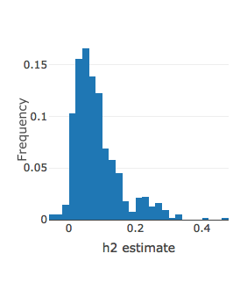
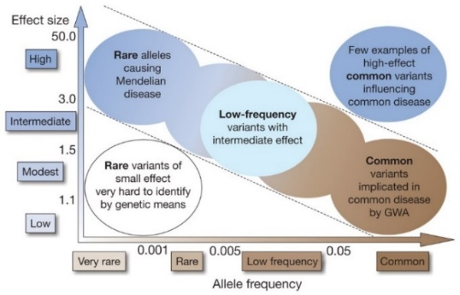
Introduction Polygenic Risk Scoring
Many complex traits and diseases in humans are heritable:
Degree of heritability determines the value of using genetics for risk prediction
For many traits and diseases there will be thousands of genetic variants that each contribute with a small effect on disease risk
Rare variant with large effects will only explain small proportion of h² (low predictive potential)
Common variants with small effects can explain larger proportion of h² (high predictive potential)
Need large data sets to accurately estimate small to moderate effects => improve prediction accuracy
(http://ldsc.broadinstitute.org/)
(Manolio et al. 2009)
Notes:
Many complex traits and diseases in humans are heritable including CAD:
Heritability for CAD is estimated to be between 40% – 60%
As the degree of heritability determines the value of using genetics for risk prediction it suggest that using genetic information could be useful for predicting CAD risk
One of the challenges is that many traits and diseases including CAD will be influenced by thousands of genetic variants that each contribute with a small effect on disease risk
This means that we need very large data sets in order to accurately estimate these effects before we can use them in risk prediction

Slide 5
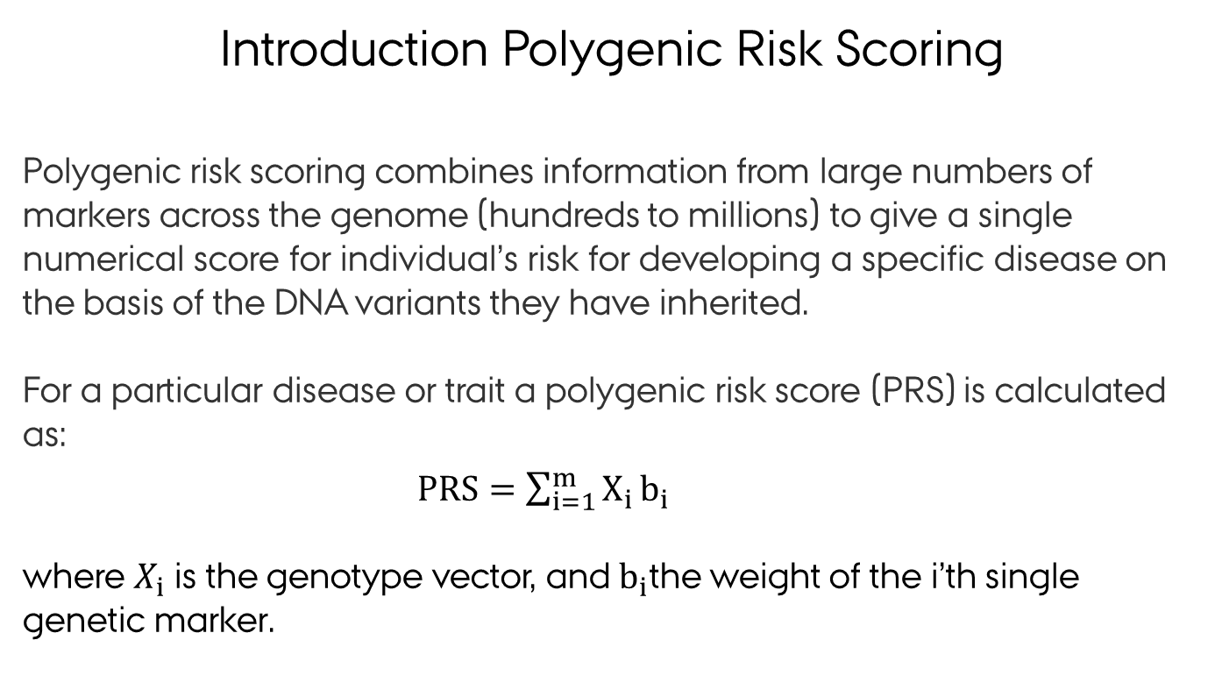
Introduction Polygenic Risk Scoring
Polygenic risk scoring combines information from large numbers of markers across the genome (hundreds to millions) to give a single numerical score for individual’s risk for developing a specific disease on the basis of the DNA variants they have inherited.
For a particular disease or trait a polygenic risk score​ (PRS) is calculated as:
$PRS=\sum_{i=1}^{m}{X_{i}}b_{i}$
where $X_{i}$ is the genotype vector, and $b_{i}$the weight of the i’th single genetic marker.
The PRS tends to follow a normal distribution
Notes:
The genetic risk is quantified using a genetic risk score combines information from large numbers of markers across the genome (hundreds to millions) to give a single numerical score for individual’s risk for developing a disease:
For a particular disease or trait a polygenic risk score​ is constructed as weighted average of the genotypes as shown in the matemathical expression on this slide
The polygenic risk score tend to be normally distributed as shown in the figure to the right and using this score we can identify individuals in the extreme tails of the distribution with high or low genetic risk
We can also rank individuals according to their risk score and compare that to their observed disease profile.
A polygenic risk score is a good predictor if the relationship between predicted risk and observed disease status is S-shaped as shown in the figure to the left

Slide 6
Introduction Polygenic Risk Scoring
Terminology: Polygenic risk scores, polygenic scores, genomic risk score, genetic scores, genetic predispostion, genetic value, genomic breeding value is (more or less) the same thing.
Genomic prediction used for many years in animal and plant breeding (e.g. Meuwissen et al. 2001)
Genomic prediction (i.e. polygenic risk scoring) in humans:
Larger GWAS sample size = more precision for effect estimates
Development of methods that combine genome-wide sets of variants
Large Biobanks for validation and testing of genetic risk scores
Ability to identify clinically meaningfull increases in disease risk predictions
Notes:
The genetic risk is quantified using a genetic risk score combines information from large numbers of markers across the genome (hundreds to millions) to give a single numerical score for individual’s risk for developing a disease:
For a particular disease or trait a polygenic risk score​ is constructed as weighted average of the genotypes as shown in the matemathical expression on this slide
The polygenic risk score tend to be normally distributed as shown in the figure to the right and using this score we can identify individuals in the extreme tails of the distribution with high or low genetic risk
We can also rank individuals according to their risk score and compare that to their observed disease profile.
A polygenic risk score is a good predictor if the relationship between predicted risk and observed disease status is S-shaped as shown in the figure to the left

Slide 7
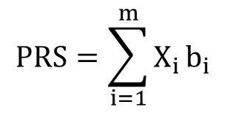
Introduction Polygenic Risk Scoring
Polygenic risk scores can be a powerful approach to identify individuals with higher (or lower) risk of particular diseases:
$$PRS=\sum_{i=1}^{m}{X_{i}}b_{i}$$
(Khera et al. 2018)
Individuals ranked according to their polygenic risk score for coronary artery disease (CAD)
Individuals in the extreme upper tail of the PRS distribution have increased risk for CAD
Notes:
The genetic risk is quantified using a genetic risk score combines information from large numbers of markers across the genome (hundreds to millions) to give a single numerical score for individual’s risk for developing a disease:
For a particular disease or trait a polygenic risk score​ is constructed as weighted average of the genotypes as shown in the matemathical expression on this slide
The polygenic risk score tend to be normally distributed as shown in the figure to the right and using this score we can identify individuals in the extreme tails of the distribution with high or low genetic risk
We can also rank individuals according to their risk score and compare that to their observed disease profile.
A polygenic risk score is a good predictor if the relationship between predicted risk and observed disease status is S-shaped as shown in the figure to the left

Slide 8
Introduction Polygenic Risk Scoring
Which data do we need to perform polygenic risk scoring?
Which methods should we use to compute the polygenic risk scores?
How do we evaluate the predictive ability of the polygenic risk scores?
Notes:
The genetic risk is quantified using a genetic risk score combines information from large numbers of markers across the genome (hundreds to millions) to give a single numerical score for individual’s risk for developing a disease:
For a particular disease or trait a polygenic risk score​ is constructed as weighted average of the genotypes as shown in the matemathical expression on this slide
The polygenic risk score tend to be normally distributed as shown in the figure to the right and using this score we can identify individuals in the extreme tails of the distribution with high or low genetic risk
We can also rank individuals according to their risk score and compare that to their observed disease profile.
A polygenic risk score is a good predictor if the relationship between predicted risk and observed disease status is S-shaped as shown in the figure to the left

Slide 9
Outline
Introduction to Polygenic Risk Scoring
Data used for Polygenic Risk Scores
Training/Validation
Individidual level or summary statistic data
Methods for Computing Polygenic Risk Scores
Standard approach based on LD pruning and thresholding (P+T)
Bayesion approach using shrinkage estimation (e.g. Ldpred, BayesR)
Multiple trait approaches
Methods for Evaluating Polygenic Risk Scores
Population or individual level measures
Quantitative and binary traits
Expected accuracies
Clinical Utility of Polygenic Risk Scores
Notes:
The genetic risk is quantified using a genetic risk score combines information from large numbers of markers across the genome (hundreds to millions) to give a single numerical score for individual’s risk for developing a disease:
For a particular disease or trait a polygenic risk score​ is constructed as weighted average of the genotypes as shown in the matemathical expression on this slide
The polygenic risk score tend to be normally distributed as shown in the figure to the right and using this score we can identify individuals in the extreme tails of the distribution with high or low genetic risk
We can also rank individuals according to their risk score and compare that to their observed disease profile.
A polygenic risk score is a good predictor if the relationship between predicted risk and observed disease status is S-shaped as shown in the figure to the left

Slide 10
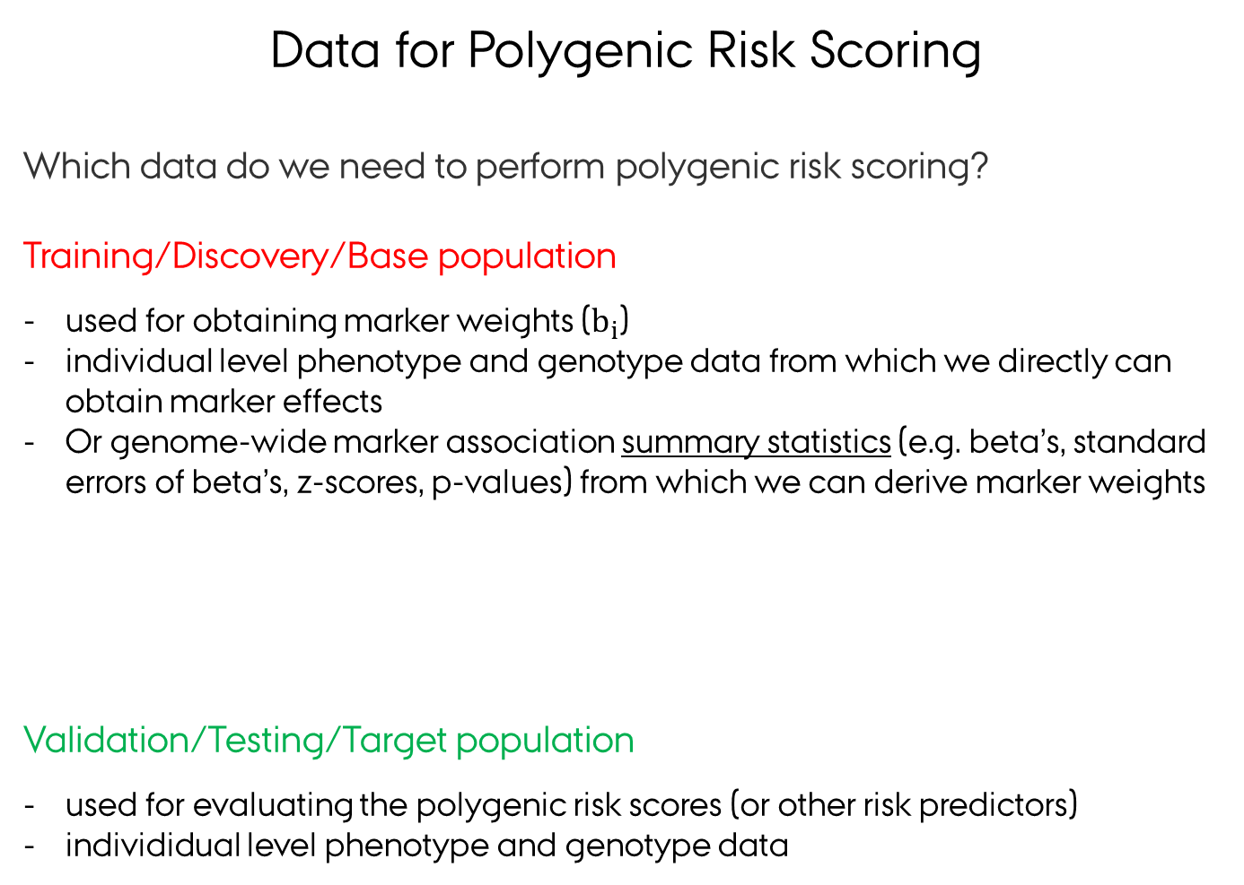
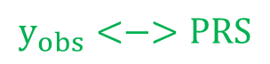
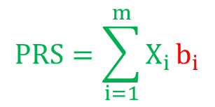
Data for Polygenic Risk Scoring
Which data do we need to perform polygenic risk scoring?
Training/Discovery/Base population
used for obtaining marker weights ($b_{i}$)
individual level phenotype and genotype data from which we directly can obtain marker effects
Or genome-wide marker association summary statistics (e.g. beta’s, standard errors of beta’s, z-scores, p-values) from which we can derive marker weights
Validation/Testing/Target population
used for evaluating the polygenic risk scores (or other risk predictors)
individidual level phenotype and genotype data
$$PRS=\sum_{i=1}^{m}{X_{i}}b_{i}$$
$$y_{obs}<−>PRS$$
Notes:
The genetic risk is quantified using a genetic risk score combines information from large numbers of markers across the genome (hundreds to millions) to give a single numerical score for individual’s risk for developing a disease:
For a particular disease or trait a polygenic risk score​ is constructed as weighted average of the genotypes as shown in the matemathical expression on this slide
The polygenic risk score tend to be normally distributed as shown in the figure to the right and using this score we can identify individuals in the extreme tails of the distribution with high or low genetic risk
We can also rank individuals according to their risk score and compare that to their observed disease profile.
A polygenic risk score is a good predictor if the relationship between predicted risk and observed disease status is S-shaped as shown in the figure to the left

Slide 11
Data for Polygenic Risk Scoring
Training/Discovery/Base population
How was the disease phenotype defined?
What are the number of observations, cases/controls?
Which co-factors was used in the GWAS analyses?
Which ancestry and environment characteristics?
What are the characteristics of the study population (males, females, both)?
Can I get access to the data?
Validation/Testing/Target population
Same considerations as above
Overlap in markers used in discovery/target population?
Same ancestry and environment characteristics will increase accuracy
Independence of individuals in discovery and target population
Important to always perform extensive quality control of your training and validation data
(Choi et al. 2020)
Notes:
The genetic risk is quantified using a genetic risk score combines information from large numbers of markers across the genome (hundreds to millions) to give a single numerical score for individual’s risk for developing a disease:
For a particular disease or trait a polygenic risk score​ is constructed as weighted average of the genotypes as shown in the matemathical expression on this slide
The polygenic risk score tend to be normally distributed as shown in the figure to the right and using this score we can identify individuals in the extreme tails of the distribution with high or low genetic risk
We can also rank individuals according to their risk score and compare that to their observed disease profile.
A polygenic risk score is a good predictor if the relationship between predicted risk and observed disease status is S-shaped as shown in the figure to the left

Slide 12
Outline
Introduction to Polygenic Risk Scoring
Data used for Polygenic Risk Scores
Training/Validation
Individidual level or summary statistic data
Methods for Computing Polygenic Risk Scores
Standard approach based on LD pruning and thresholding (P+T)
Bayesion approach using shrinkage estimation (e.g. Ldpred, BayesR)
Multiple trait approaches
Methods for Evaluating Polygenic Risk Scores
Population or individual level measures
Quantitative and binary traits
Expected accuracies
Clinical Utility of Polygenic Risk Scores
Notes:
The genetic risk is quantified using a genetic risk score combines information from large numbers of markers across the genome (hundreds to millions) to give a single numerical score for individual’s risk for developing a disease:
For a particular disease or trait a polygenic risk score​ is constructed as weighted average of the genotypes as shown in the matemathical expression on this slide
The polygenic risk score tend to be normally distributed as shown in the figure to the right and using this score we can identify individuals in the extreme tails of the distribution with high or low genetic risk
We can also rank individuals according to their risk score and compare that to their observed disease profile.
A polygenic risk score is a good predictor if the relationship between predicted risk and observed disease status is S-shaped as shown in the figure to the left

Slide 13
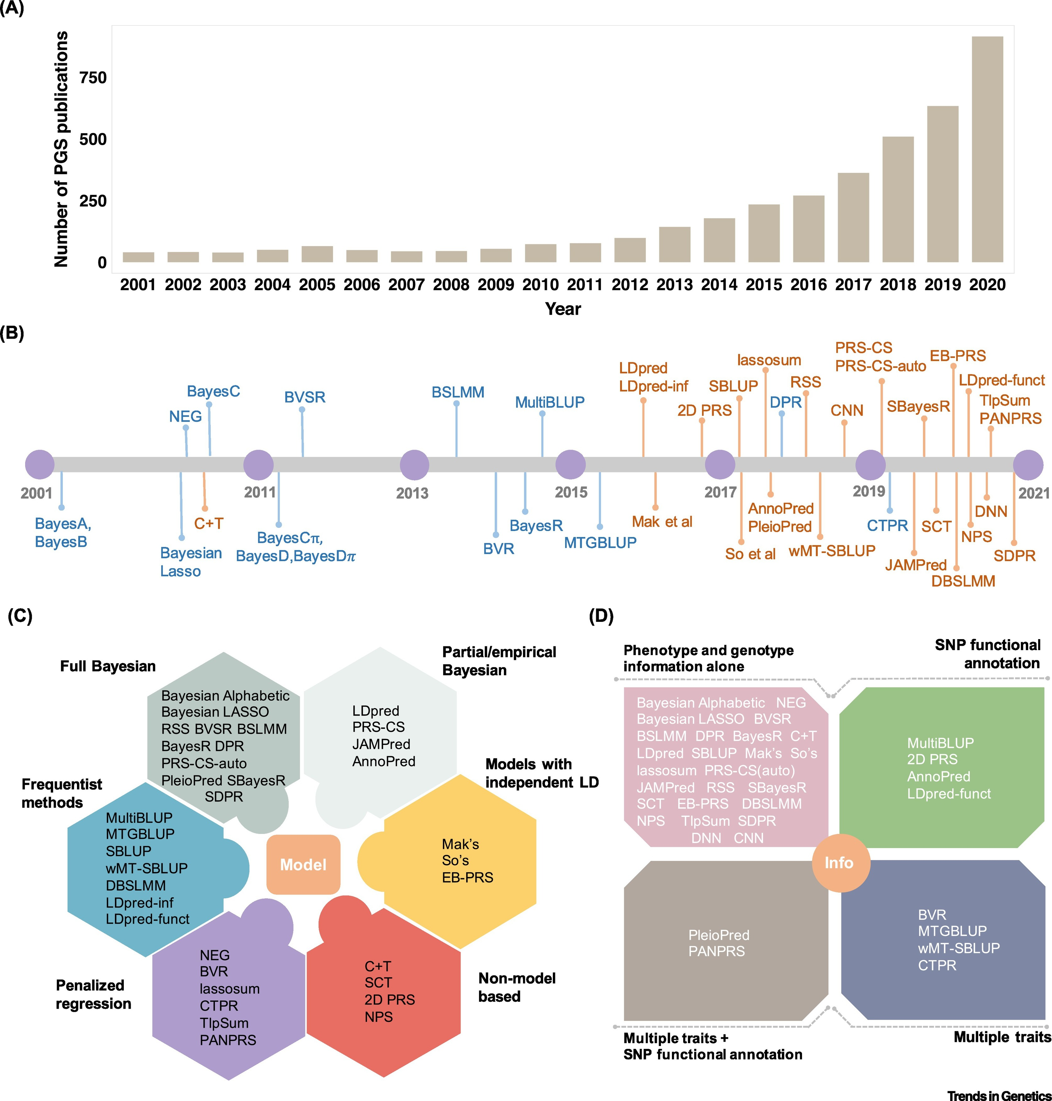
Methods for Computing Polygenic Risk Scores
Which methods should we use to compute the marker weights used in the polygenic risk scores?
(Ma & Zhou 2021)
Notes:
1. (A) The number of PGS publications increased substantially from 2001 to 2020, highlighting the popularity of PGS analysis. The number of publications was obtained by searching using the key terms 'polygenic + score + or + polygenic + risk + score' on PubMed. (B) Timeline of commonly used PGS methods developed over the past two decades. These PGS methods either use individual-level genotype and phenotype data as the input (blue) or use summary statistics as the input (orange). (C) PGS methods can be categorized into six categories based on their model and fitting strategy. Specifically, some PGS methods are model-based and are described as a formal model with a corresponding fitting algorithm (colors other than red), whereas others are algorithm-based and are described as an algorithm or a fitting procedure without an explicit model (red). The model-based PGS methods can be further categorized based on the underlying inference algorithm: some are fully Bayesian and use Markov chain Monte Carlo (MCMC) for model fitting (grey); some are partial/empirical Bayesian that optimize particular hyper-parameters through grid search while obtaining other parameter estimates through MCMC (light grey); some are approximate approaches that assume independence across SNPs and use optimization for effect size estimation (yellow); some are frequentist in nature and can obtain an analytic solution without optimization (blue); and some are based on penalized regression and use iterative algorithms for parameter estimation (purple). (D) PGS methods can also be categorized in terms of the information used for PGS construction. Most PGS methods use only genotype and phenotype information from the GWAS on the trait of interest (pink). Some recent PGS methods can use additional SNP annotation information obtained from external data sources (green) and/or other phenotype information in addition to the phenotype of interest (taupe and navy blue). Box 1. Predicting new observations through PGS construction We can predict phenotypes for newly observed individuals using the estimated SNP effect size ^ β from the model in Equation 1 (main text). Specifically, once we have obtained the p-vector of genotypes, xl , for a new individual l we can simply plug in the SNP effect estimates to obtain the predicted phenotype value (i.e., the PGS), as ^yl ¼ xlβ^. Common modeling assumptions for SNP effect sizes Because p >> n, we will need to make additional modeling assumptions for the effect size β to make the model in Equation 1 (main text) identifiable. Both sparse and polygenic modeling assumptions have been proposed for β. A common sparse modeling assumption for β is the point-normal distribution, which assumes that the effect size of SNP j comes from a mixture of a normal distribution and a point mass at zero, expressed as: β j π N 0; σ2 β þ ð Þ 1 − π δ0 ½I where, with proportion π, the SNP effect size follows a normal distribution with mean zero and variance σβ 2 , and with a proportion of 1 − π the effect size is exactly zero – hence the point mass at zero, δ0. In the point-normal distribution, π is usually assumed to be small, representing the prior belief that a small proportion of SNPs have non-zero effects. A common polygenic modeling assumption for β is the normal assumption, which assumes that all SNPs have non-zero effects and that each effect size follows a normal distribution: β j N 0; σ2 β ½II with mean zero and variance σβ 2 . The model in Equation 1 (main text), when paired with the normality assumption for β in Equation II, has a wide variety of applications and many names. For example, it is referred to as the linear mixed model (LMM) per the resulting random effects term of the combined genetic effects; as the infinitesimal model per its polygenic assumption on the effect sizes Xβ; as the ridge regression in statistics literature; as the L2 regularization when viewed as a penalized regression; as the best linear unbiased prediction (BLUP) when the focus is on the predicted values; or as the REML when the REML algorithm is used for inference. All these names are used interchangeably in the PGS literature, and we simply refer to the model as the LMM in the present review. Trends in Genetics

Slide 14
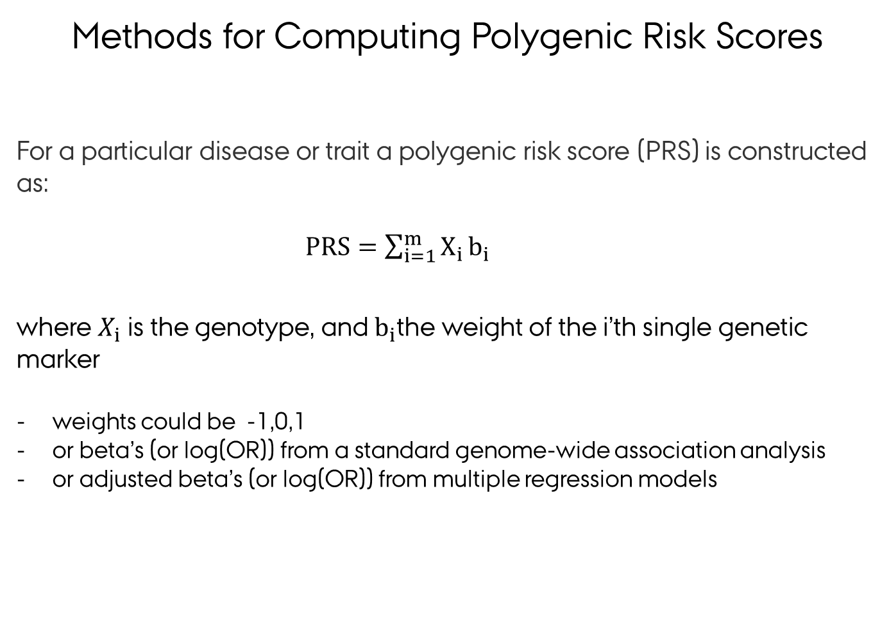
Methods for Computing Polygenic Risk Scores
For a particular disease or trait a polygenic risk score​ (PRS) is constructed as:
$PRS=\sum_{i=1}^{m}{X_{i}}b_{i}$
where $X_{i}$ is the genotype, and $b_{i}$the weight of the i’th single genetic marker
weights could be -1,0,1
or beta’s (or log(OR)) from a standard genome-wide association analysis
or adjusted beta’s (or log(OR)) from multiple regression models
Notes:
The genetic risk is quantified using a genetic risk score combines information from large numbers of markers across the genome (hundreds to millions) to give a single numerical score for individual’s risk for developing a disease:
For a particular disease or trait a polygenic risk score​ is constructed as weighted average of the genotypes as shown in the matemathical expression on this slide
The polygenic risk score tend to be normally distributed as shown in the figure to the right and using this score we can identify individuals in the extreme tails of the distribution with high or low genetic risk
We can also rank individuals according to their risk score and compare that to their observed disease profile.
A polygenic risk score is a good predictor if the relationship between predicted risk and observed disease status is S-shaped as shown in the figure to the left

Slide 15
Methods for Computing Polygenic Risk Scores
Which markers should be included in the polygenic risk score?
Including only genome-wide significant SNPs in a prediction model usually leads to poor prediction:
polygenic nature of many complex traits means that many true predictors do not reach genome-wide significance significance
each individually marker conveys little information, but collectively they can be important.
On the other hand, including many predictors in a model risks over-fitting:
parameter estimates achieve close matching of fitted values to the observed data, which appears good but ...
much of this apparent success amounts to “fitting statistical noise”: parameters are tuned to irreproducible features of the data, leading to poor fit to new data

Slide 16
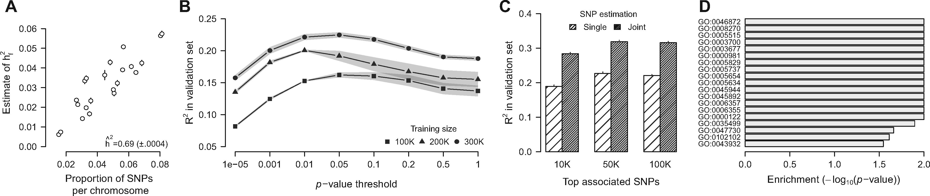
Methods for Computing Polygenic Risk Scores
Standard approach based on LD pruning and thresholding (P+T):
Test each SNP one-at-a-time in the training sample and record those that are significant at level α and their estimated effect sizes.
Account for LD (i.e. correlation) between markers using r2 threshold based on a LD reference panel (e.g. 1000G).
It is common to repeat for different α and r2 in order to try to maximise predictive success.
(Rohde et al. 2020)

Slide 17
Methods for Computing Polygenic Risk Scores
A better solution to the over-fitting problem is offered by penalised (or shrinkage) regression in which a penalty in the residual sum of squares or log-likelihood “shrinks” parameter estimates towards zero:
It can also be motivated in Bayesian terms: the penalty function should reflect available knowledge about the true distribution of effect sizes of marker alleles, i.e. your prior distribution.
(de los Campos et al. 2013, Rohde et al. 2020)

Slide 18
Methods for Computing Polygenic Risk Scores
Bayesian linear regression (BLR) models:
unified mapping of genetic variants, estimation of genetic parameters (e.g. heritability) and prediction of disease risk
handles different genetic architectures (few large, many small effects)
scale to large data (e.g. sparse LD)
(e.g. Lloyd-Jones et al. 2019, Vilhjálmsson et al. 2015)

Slide 19
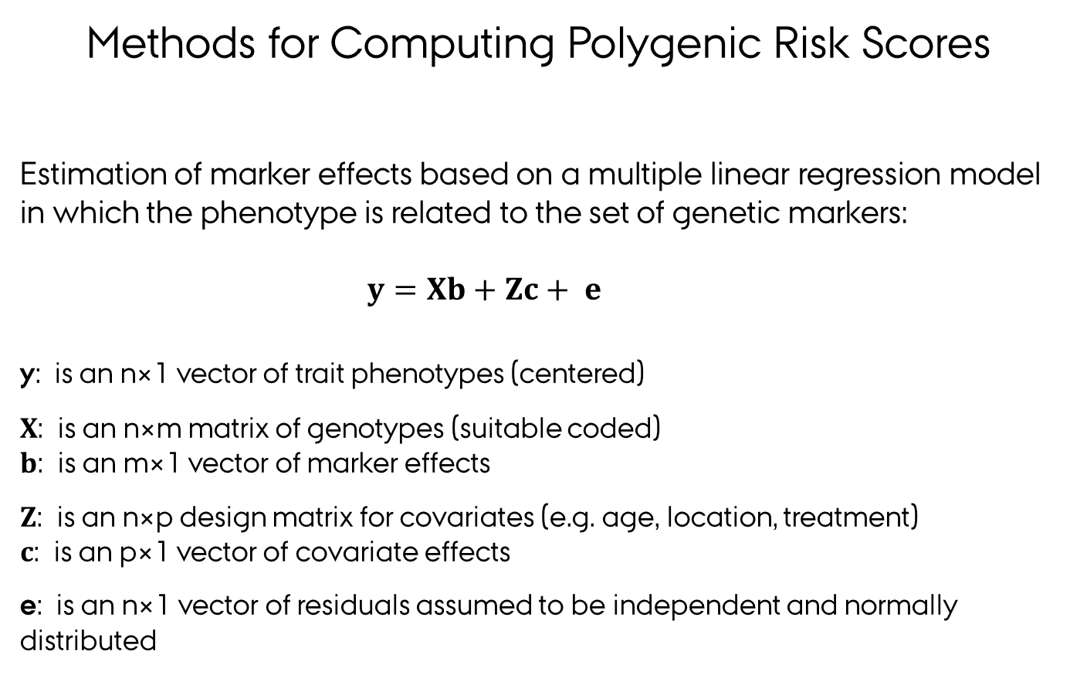
Methods for Computing Polygenic Risk Scores
Estimation of marker effects based on a multiple linear regression model in which the phenotype is related to the set of genetic markers:
$y=Xb+Zc+ e$
y: is an n×1 vector of trait phenotypes (centered)
$X$: is an n×m matrix of genotypes (suitable coded)
$b$: is an m×1 vector of marker effects
$Z$: is an n×p design matrix for covariates (e.g. age, location, treatment)
$c$: is an p×1 vector of covariate effects
e: is an n×1 vector of residuals assumed to be independent and normally distributed

Slide 20
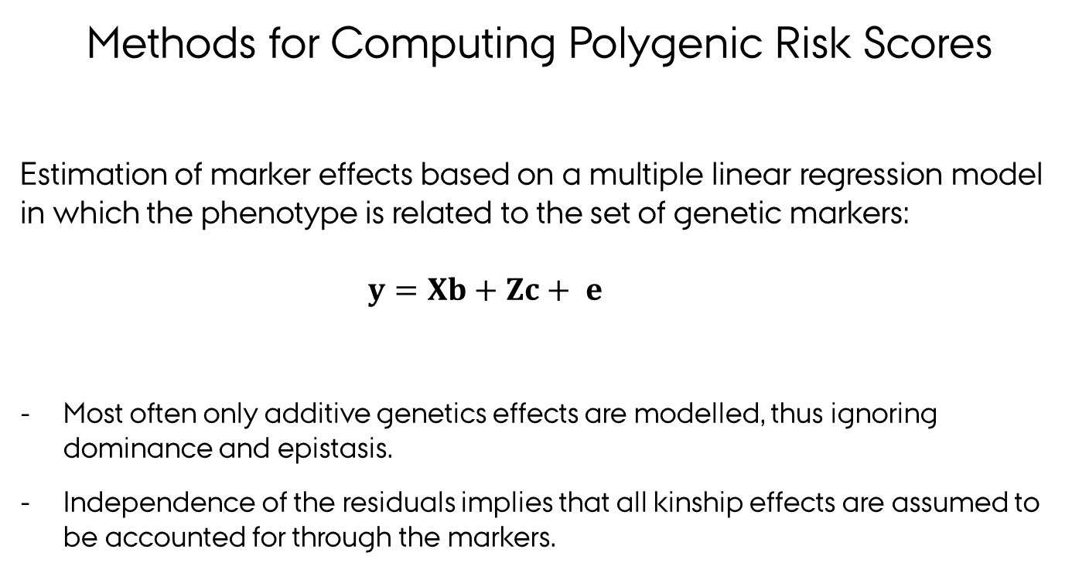
Methods for Computing Polygenic Risk Scores
Estimation of marker effects based on a multiple linear regression model in which the phenotype is related to the set of genetic markers:
$y=Xb+Zc+ e$
Most often only additive genetics effects are modelled, thus ignoring dominance and epistasis.
Independence of the residuals implies that all kinship effects are assumed to be accounted for through the markers.

Slide 21
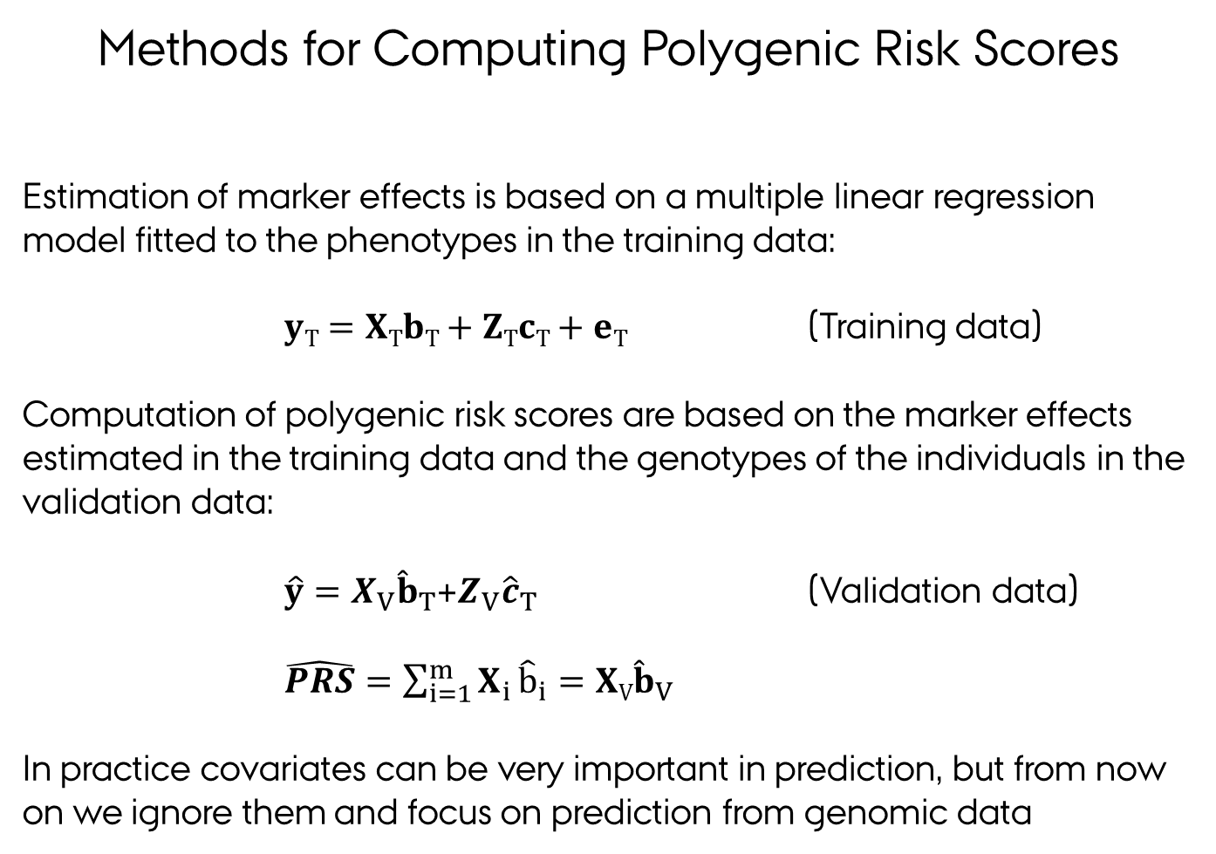
Methods for Computing Polygenic Risk Scores
Estimation of marker effects is based on a multiple linear regression model fitted to the phenotypes in the training data:
$yT=XTbT+ZTcT+eT$ (Training data)
Computation of polygenic risk scores are based on the marker effects estimated in the training data and the genotypes of the individuals in the validation data:
$\hat{y}=X_{V}{\hat{b}}_{T}$+$Z_{V}{\hat{c}}_{T}$ (Validation data)
$\hat{PRS}=\sum_{i=1}^{m}{X_{i}}{\hat{b}}_{i}=XV{\hat{b}}_{V}$
In practice covariates can be very important in prediction, but from now on we ignore them and focus on prediction from genomic data
Notes:
After fitting a prediction model in a training sample, we can measure success using a test sample for which the phenotype is available (but these individuals must not form part of the training population). If we don’t have a suitable test sample, we can artificially create one by holding back a fraction (say 0.1) from the training population; predictive accuracy then tends to be understated because the full training sample is not used to fit the model; conversely the test individuals are statistically the same as the training individuals, which may lead to an overstatement of predictive accuracy relative to future individuals with slightly different characteristics. Repeatedly estimating prediction accuracy by holding back a fraction of the training population is called cross-validation (CV). The held-back individuals may be resampled at random each time, or sampled systematically so that each individual is a member of the test sample a fixed number of times (typically once, called k-fold CV where 1/k is the fraction of individuals in each test sample).

Slide 22
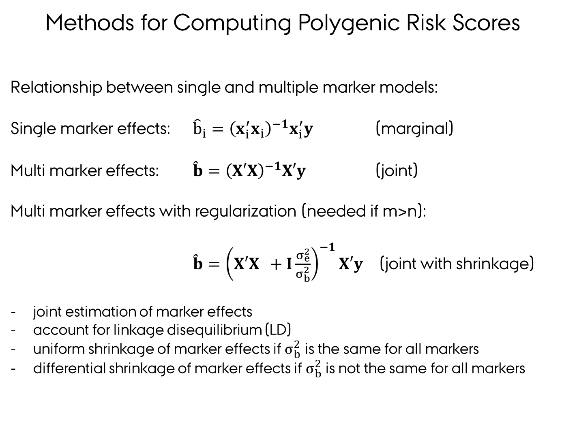
Methods for Computing Polygenic Risk Scores
Relationship between single and multiple marker models:
Single marker effects: ${\hat{b}}_{i}={\left(x_{i}^{′}x_{i}\right)}^{−1}x_{i}^{′}y$ (marginal)
Multi marker effects: $\hat{b}={\left(X′X\right)}^{−1}X′y$ (joint)
Multi marker effects with regularization (needed if m>n):
$\hat{b}={\left(X′X +I\frac{σ_{e}^{2}}{σ_{b}^{2}}\right)}^{−1}X′y$ (joint with shrinkage)
joint estimation of marker effects
account for linkage disequilibrium (LD)
uniform shrinkage of marker effects if $σ_{b}^{2}$ is the same for all markers
differential shrinkage of marker effects if $σ_{b}^{2}$ is not the same for all markers

Slide 23
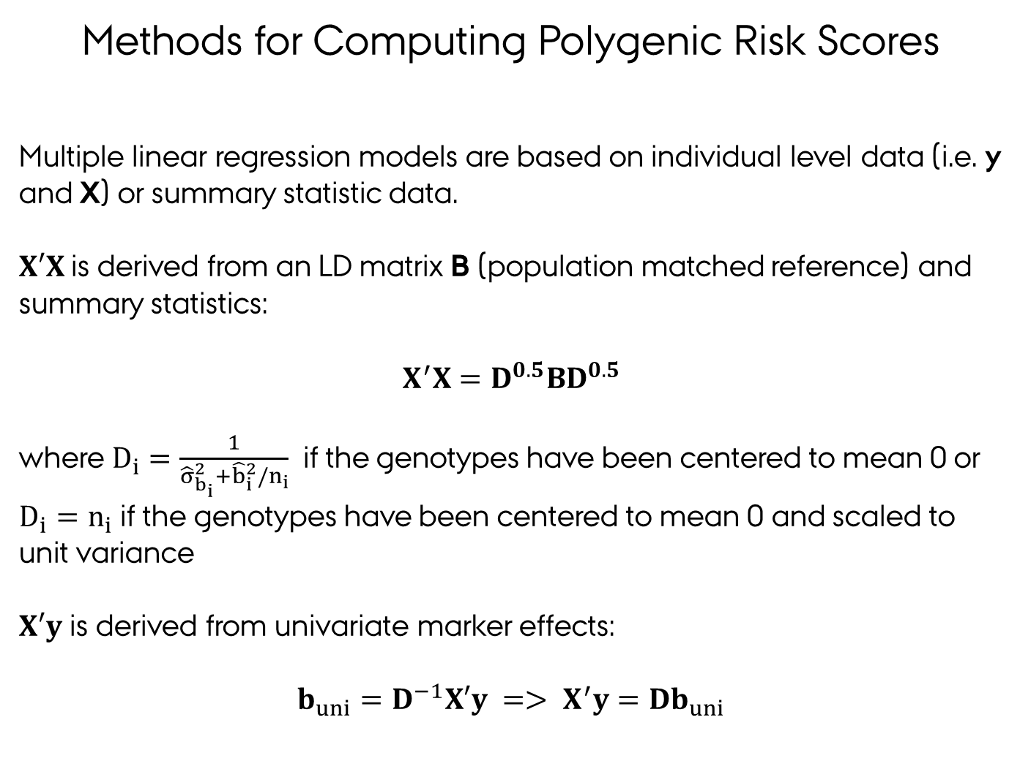
Methods for Computing Polygenic Risk Scores
Multiple linear regression models are based on individual level data (i.e. y and X) or summary statistic data.
$X′X$is derived from an LD matrix B (population matched reference) and summary statistics:
$$X^{′}X=D^{0.5}BD^{0.5}$$
where $D_{i}=\frac{1}{{\hat{σ}}_{b_{i}}^{2}+{\hat{b}}_{i}^{2}/n_{i}}$if the genotypes have been centered to mean 0 or $D_{i}=n_{i}$ if the genotypes have been centered to mean 0 and scaled to unit variance
$X′y$ is derived from univariate marker effects:
$$b_{uni}=D^{−1}X′y => X^{′}y=Db_{uni}$$
(Lloyd-Jones et al. 2019
Vilhjálmsson et al. 2015)

Slide 24
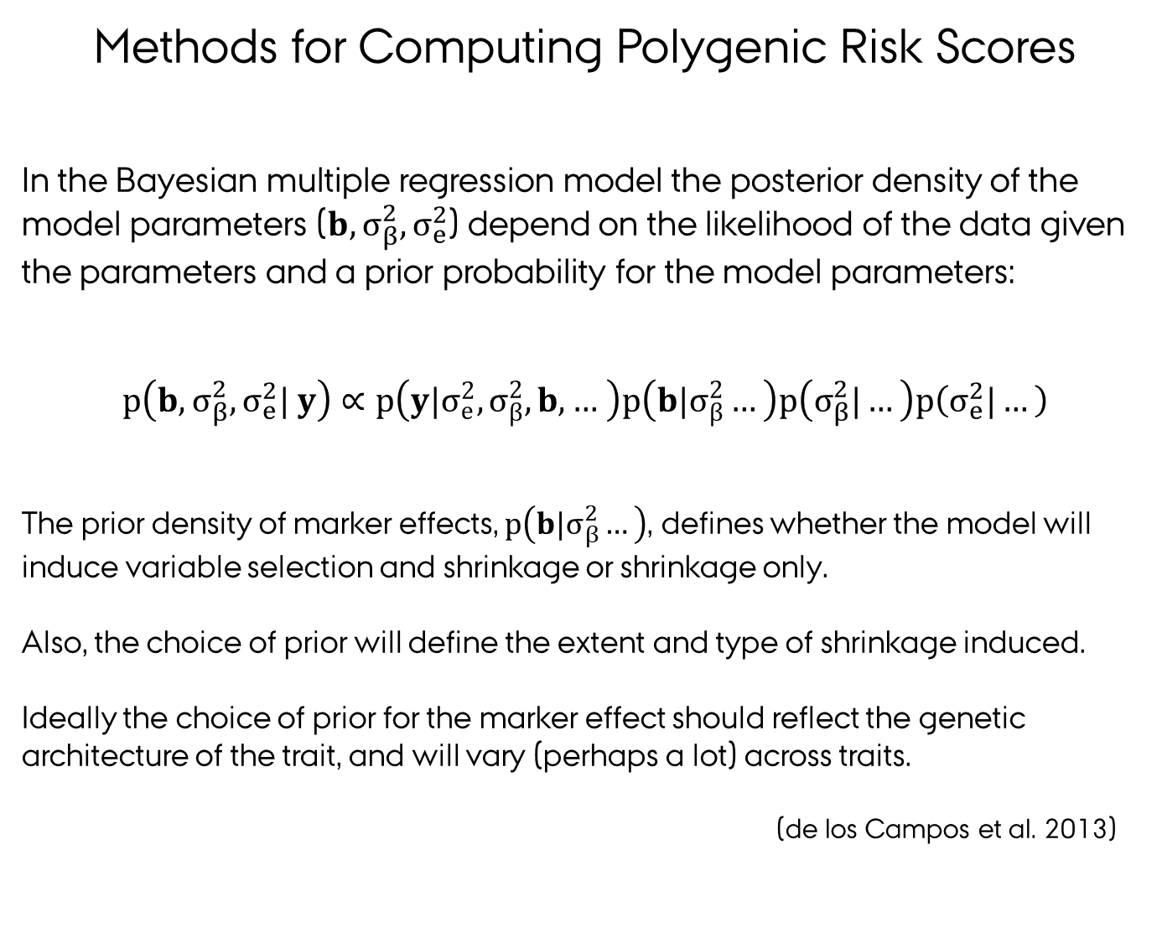
Methods for Computing Polygenic Risk Scores
In the Bayesian multiple regression model the posterior density of the model parameters ($b,σ_{β}^{2},σ_{e}^{2}$) depend on the likelihood of the data given the parameters and a prior probability for the model parameters:
$$p\left(b,σ_{β}^{2},σ_{e}^{2}| y\right)∝p\left(y|σ_{e}^{2},σ_{β}^{2}, b, … \right)p\left(b|σ_{β}^{2}…\right)p\left(σ_{β}^{2}|…\right)p\left(σ_{e}^{2}|…\right)$$
The prior density of marker effects, $p\left(b|σ_{β}^{2}…\right)$, defines whether the model will induce variable selection and shrinkage or shrinkage only.
Also, the choice of prior will define the extent and type of shrinkage induced.
Ideally the choice of prior for the marker effect should reflect the genetic architecture of the trait, and will vary (perhaps a lot) across traits.
(de los Campos et al. 2013)

Slide 25
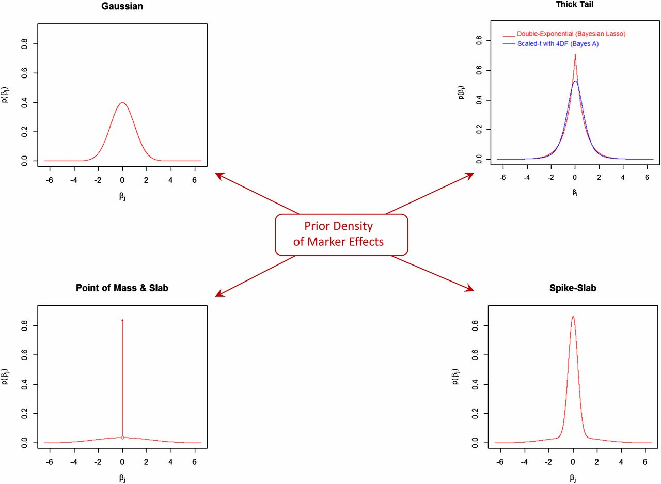
Methods for Computing Polygenic Risk Scores
Commonly used prior densities of marker effects (all with zero mean and unit variance):
The densities are organized in a way that, starting from the Gaussian in the top left corner, as one moves clockwise, the amount of mass at zero increases and tails become thicker and flatter.
(de los Campos et al. 2013)

Slide 26
Methods for Computing Polygenic Risk Scores
Commonly used prior densities of marker effects :
BLUP: Assigning a Gaussian prior to β implies that the posterior means are the BLUP estimates (same as Ridge Regression).
Bayesian Lasso: Assigning a double-exponential or Laplace prior is the density used in the Bayesian LASSO
Bayes A: similar to ridge regression but t-distribution prior (rather than Gaussian) for the βj ; variance comes from an inverse-χ 2 instead of being fixed. Estimation via Gibbs sampling.
Bayes Cπ: uses a “rounded spike” (low-variance Gaussian) at origin many small effects can contribute to polygenic component, reduces the dimensionality of the model (makes Gibbs sampling feasible).
Bayes R: Hierarchical Bayesian mixture model with 4 Gaussian components, with variances scaled by 0, 0.0001 , 0.001 , and 0.01 .
(de los Campos 2013, Lloyd-Jones et al. 2019, Vilhjálmsson et al. 2015)

Slide 27
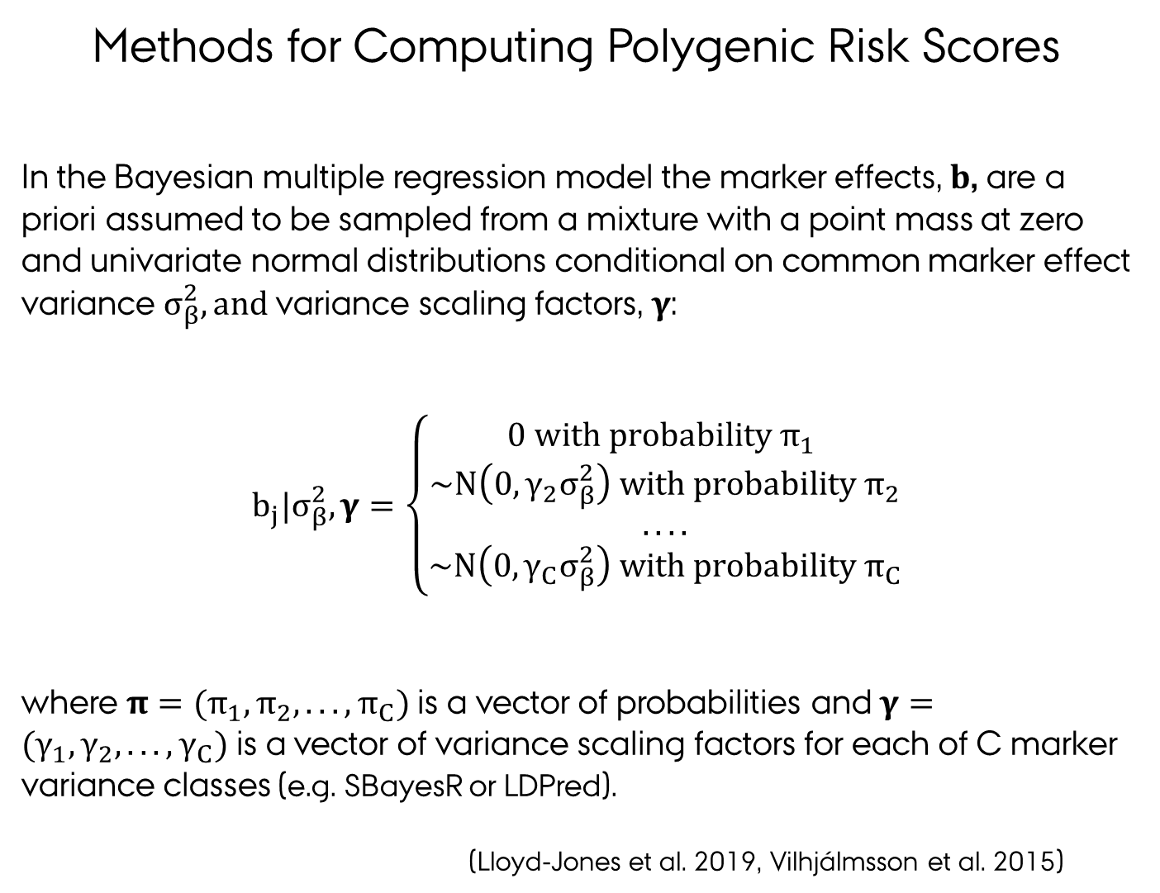
Methods for Computing Polygenic Risk Scores
In the Bayesian multiple regression model the marker effects, $b$, are a priori assumed to be sampled from a mixture with a point mass at zero and univariate normal distributions conditional on common marker effect variance $σ_{β}^{2}, and$variance scaling factors, $γ$:
$$b_{j}|σ_{β}^{2},γ=\left\{\begin{matrix}0 with probability π_{1} \\ \sim N\left(0,{γ_{2}σ}_{β}^{2}\right) with probability π_{2} \\ .... \\ \sim N\left(0,{γ_{C}σ}_{β}^{2}\right) with probability π_{C}\end{matrix}\right.$$
where $π=(π_{1},π_{2},...,π_{C})$ is a vector of probabilities and $γ=(γ_{1},γ_{2},...,γ_{C})$ is a vector of variance scaling factors for each of C marker variance classes (e.g. SBayesR or LDPred).
(Lloyd-Jones et al. 2019, Vilhjálmsson et al. 2015)

Slide 28
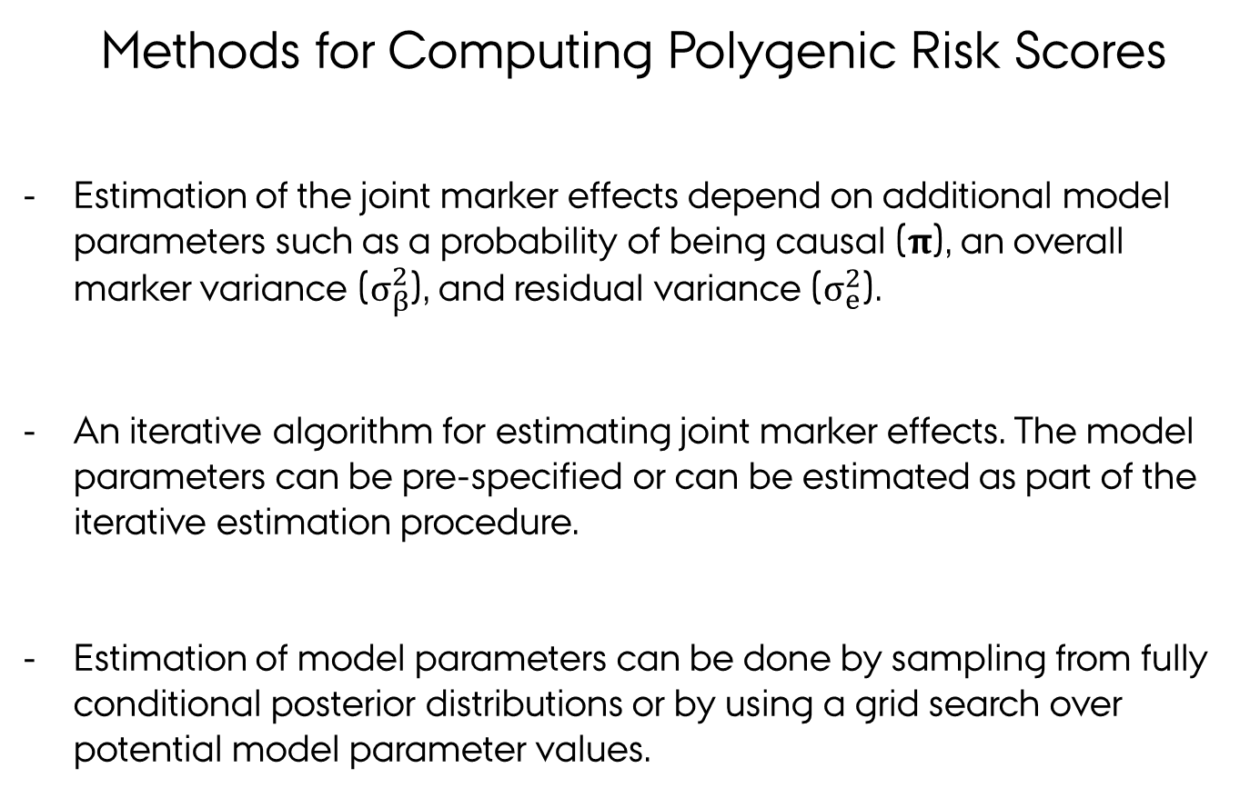
Methods for Computing Polygenic Risk Scores
Estimation of the joint marker effects depend on additional model parameters such as a probability of being causal ($π$), an overall marker variance ($σ_{β}^{2}$), and residual variance ($σ_{e}^{2}$).
An iterative algorithm for estimating joint marker effects. The model parameters can be pre-specified or can be estimated as part of the iterative estimation procedure.
Estimation of model parameters can be done by sampling from fully conditional posterior distributions or by using a grid search over potential model parameter values.

Slide 29
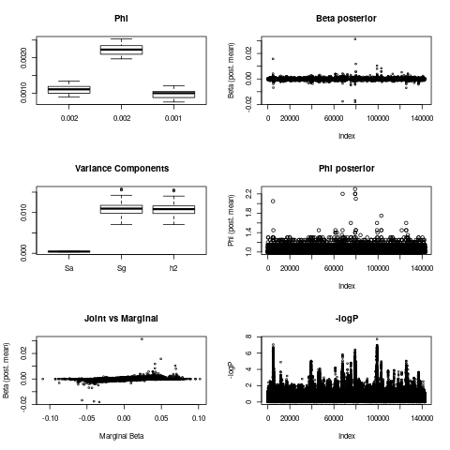
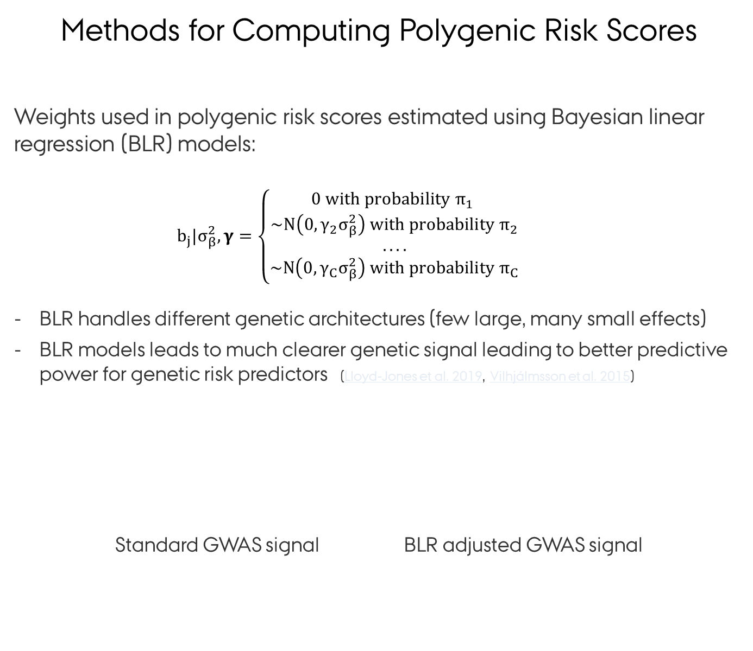
Methods for Computing Polygenic Risk Scores
Weights used in polygenic risk scores estimated using Bayesian linear regression (BLR) models:
$b_{j}|σ_{β}^{2},γ=\left\{\begin{matrix}0 with probability π_{1} \\ \sim N\left(0,{γ_{2}σ}_{β}^{2}\right) with probability π_{2} \\ .... \\ \sim N\left(0,{γ_{C}σ}_{β}^{2}\right) with probability π_{C}\end{matrix}\right.$
BLR handles different genetic architectures (few large, many small effects)
BLR models leads to much clearer genetic signal leading to better predictive power for genetic risk predictors (Lloyd-Jones et al. 2019, Vilhjálmsson et al. 2015)
Standard GWAS signal BLR adjusted GWAS signal
Effect size
No effect
Small effect
……….
Large effect
Notes:
The weights used in the polygenic risk scores can be estimated with a Bayesian linear regression (BLR) model using association statistics from GWAS studies
The matemathical details of the method are rather technical but the the method allows the marker effects to be of different size - ranging from 0 effect - to small effects - to large effects - which is what is defined by the matemathical expression on this slide
The Bayesian linear regression model handle different genetic architectures and the complicated correlation structures that are present in GWAS data
In general this procedure leads to much clearer genetic signal providing better predictive power for genetic risk predictors

Slide 30
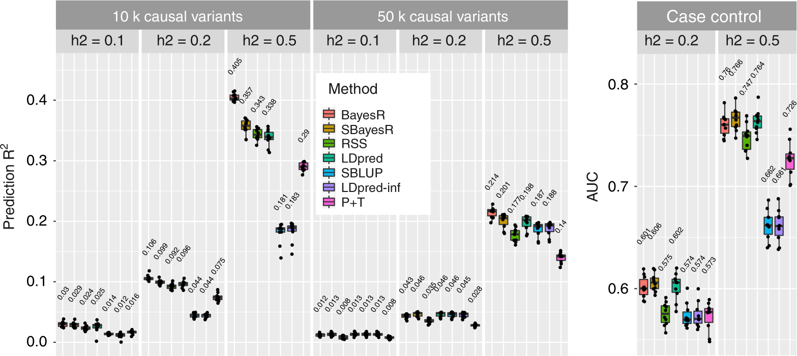
Methods for Computing Polygenic Risk Scores
Comparison of polygenic risk score methods on simulated data:
(Lloyd-Jones et al. 2019)
2500 variants ~ N(0, 0.01)
5000 variants ~ N(0, 0.1)
2500 variants ~ N(0, 1)
Notes:
Prediction accuracy performance for the UKB genome-wide simulation. Each panel displays boxplot summaries of the prediction R² (y-axis) or area under receiver-operating characteristic curve (AUC), in the 10,000 individual validation data set for each method (x-axis) across the 10 replicates. The simulation study contained eight scenarios that varied in the number of causal variants, 10,000 (10k) and 50,000 (10,000), and the true simulated heritability h2=(0.1,0.2,0.5)h2=(0.1,0.2,0.5). The two genetic architecture scenarios generated were 10,000 causal variants sampled under the SBayesR model, that is, 2500, 5000 and 2500 variants from each of N(0, 0.01), N(0, 0.1) and N(0, 1) distributions, respectively, and 50,000 causal variants sampled from a standard normal distribution. Case–control phenotypes were generated from the liability threshold model with a simulated disease prevalence of 0.05 and the 10,000 causal variant genetic architecture. In each panel, LDpred has two boxplot summaries, one that has been optimised for the polygenicity parameter and the other is LDpred-inf, which is displayed for comparison with SBLUP. LDpred and SBLUP were initialised with the true heritability parameter. The mean prediction accuracy across the 10 replicates is displayed above the boxplot for each method. The centre line inside the box is the median, the bottom and top of the box are the first and third quartiles, respectively (Q1 and Q3), and the lower and upper whiskers are Q1 – 1.5 IQR and Q3 + 1.5 IQR, respectively, where IQR = Q3 – Q1. The points depict the prediction accuracy for each replicate

Slide 31
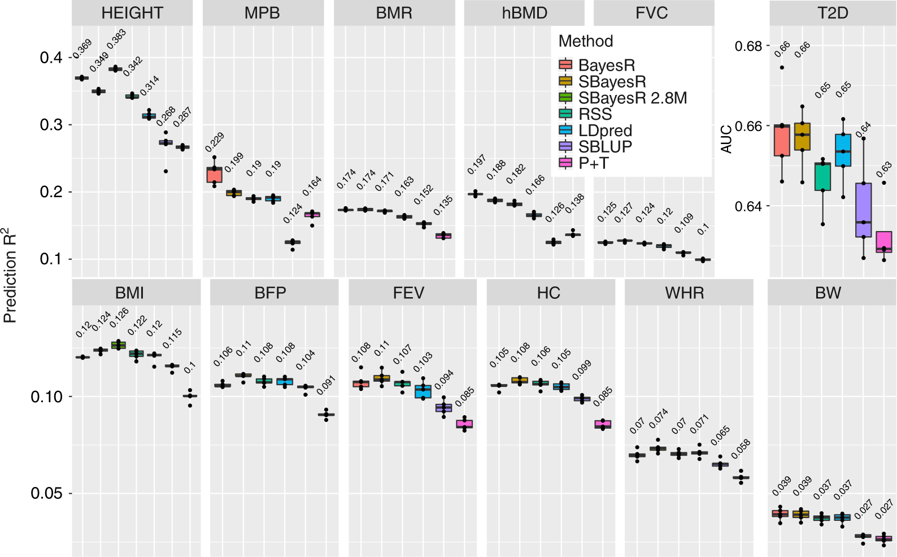
Methods for Computing Polygenic Risk Scores
Comparison of polygenic risk score methods on real data:
(Lloyd-Jones et al. 2019)
Notes:
Prediction accuracy in fivefold cross-validation for 12 traits in the UK Biobank. Panel headings describe the abbreviation for 12 traits including standing height (HEIGHT, n = 347,106), male-pattern baldness (MPB, n = 125,157), basal metabolic rate (BMR, n = 341,819), heel bone mineral density T-score (hBMD, n = 197,789), forced vital capacity (FVC, n = 317,502), type 2 diabetes (T2D, n = 274,271), body mass index (BMI, n = 346,738), body fat percentage (BFP, n = 341,633), forced expiratory volume in 1 s (FEV, n = 317,502), hip circumference (HC, n = 347,231), waist-to-hip ratio (WHR, n = 347,198) and birth weight (BW, n = 197,778). Each panel shows a boxplot summary of the prediction accuracy across the five folds with the mean across the five folds displayed above each method’s boxplot. The centre line inside the box is the median, the bottom and top of the box are the first and third quartiles, respectively (Q1 and Q3), and the lower and upper whiskers are Q1 – 1.5 IQR and Q3 + 1.5 IQR, respectively, where IQR = Q3 – Q1. The points depict the prediction accuracy for each replicate. Traits are ordered by mean estimated h2SNPhSNP2 (see Supplementary Fig. 16) from highest to lowest

Slide 32
Methods for Computing Polygenic Risk Scores
Bayesian linear regression (BLR) models:
unified mapping of genetic variants, estimation of genetic parameters (e.g. heritability) and prediction of disease risk
handles different genetic architectures (few large, many small effects)
scale to large data (e.g. sparse LD)
(e.g. Lloyd-Jones et al. 2019, Vilhjálmsson et al. 2015)
Multi-trait and multi-component Bayesian linear regression (BLR) models:
handle multiple traits => use correlated trait information
extend to multiple marker groups => use functional marker information
extend to joint analysis of individual level and summary data
(Sørensen et al. 2015, Cheng et al. 2018)

Slide 33
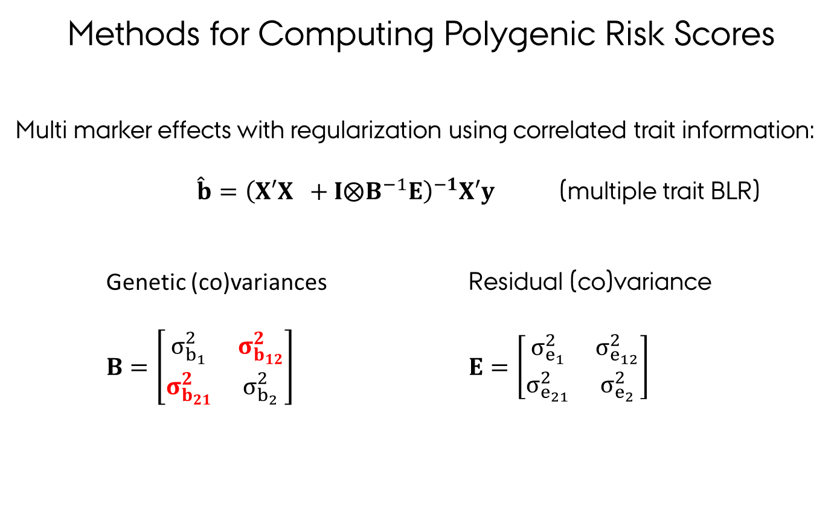
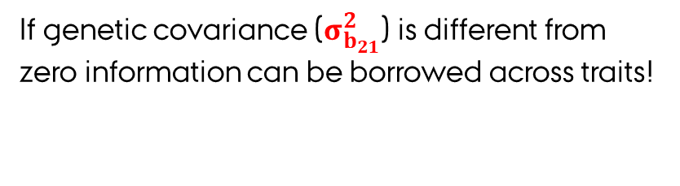
Methods for Computing Polygenic Risk Scores
Multi marker effects with regularization using correlated trait information:
$\hat{b}={\left(X′X +I⨂B^{−1}E\right)}^{−1}X′y$ (multiple trait BLR)
Genetic (co)variances Residual (co)variance
$B=\left[\begin{matrix}σ_{b_{1}}^{2} & σ_{b_{12}}^{2} \\ σ_{b_{21}}^{2} & σ_{b_{2}}^{2}\end{matrix}\right]$ $E=\left[\begin{matrix}σ_{e_{1}}^{2} & σ_{e_{12}}^{2} \\ σ_{e_{21}}^{2} & σ_{e_{2}}^{2}\end{matrix}\right]$
If genetic covariance ($σ_{b_{21}}^{2}$) is different from zero information can be borrowed across traits!

Slide 34
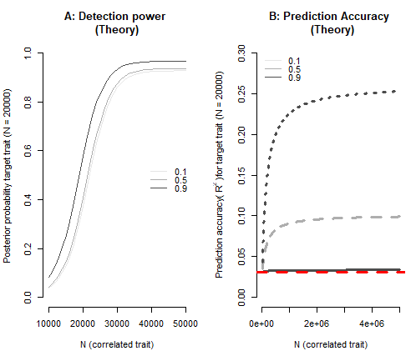
Methods for Computing Polygenic Risk Scores
The value (increase in prediction accuracy or detection power) of using correlated trait information depend on:
Panel A: MT-BLR, marker effect b=0.025 for two continous traits, r_{g}=0.1,0.3,0.9
Panel B: MT-BLUP, h²=0.3 for two continous traits, r_{g}=0.1,0.3,0.9
number of observations
heritability of the traits
genetic correlation between traits
disease prevalence
In particular, low heritability traits with small number of observations will benefit most from a multiple trait analysis with a high heritability traits with large number of observations.
Rheenen et al 2019

Slide 35
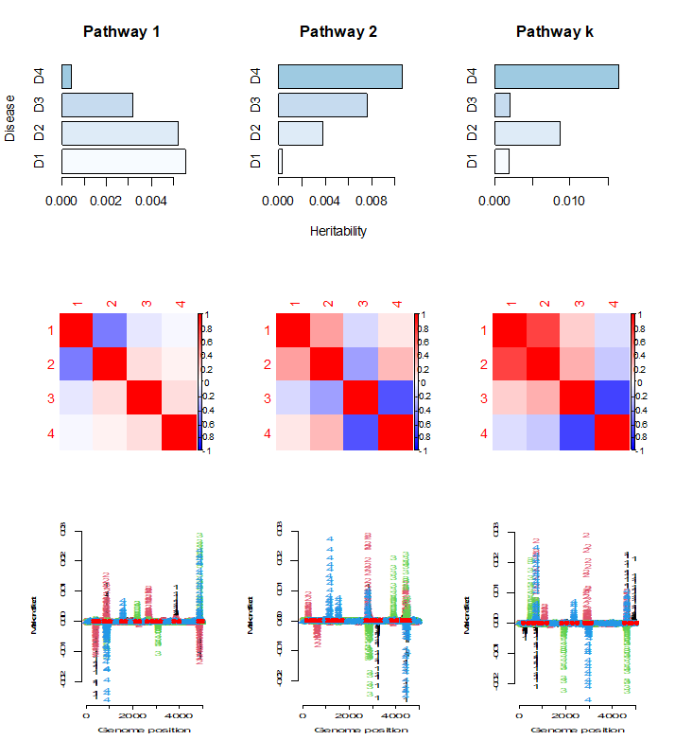
Methods for Computing Polygenic Risk Scores
MT-BLR models is used for simultaneously estimation of genetic parameters (heritability and correlation) and gene mapping:
Heritability for pathways may differ across traits (e.g. mapping of multiple genetic variants each with small effects)
Genetic correlation between traits may differ across pathways (”How joint effects of multiple markers correlates across traits”)
Mapping of genetic variants with moderate to large effects (increased detection power)

Slide 36
Methods for Computing Polygenic Risk Scores
A range of biological relevant multiple trait BLR models can be specified including:
correlated traits and/or diseases in the same population
correlated traits and/or diseases across populations
correlated traits and/or diseases across environments
use information on functional marker groups to detect functional related genetic variants each contributing small effects across traits, environments or populations
use summary statistics or individual level genotype and phenotype data (i.e. combine data from GWAS consortia and Biobanks)
The multi-trait and multi-component trait BLR models are implemented using fast and memory efficient algorithms in C++ and made publicly available in the R software package qgg (https://cran.r-project.org/web/packages/qgg).

Slide 37
Outline
Introduction to Polygenic Risk Scoring
Data used for Polygenic Risk Scores
Training/Validation
Individidual level or summary statistic data
Methods for Computing Polygenic Risk Scores
Standard approach based on LD pruning and thresholding (P+T)
Bayesion approach using shrinkage estimation (e.g. Ldpred, BayesR)
Multiple trait approaches
Methods for Evaluating Polygenic Risk Scores
Population or individual level measures
Quantitative and binary traits
Expected accuracies
Clinical Utility of Polygenic Risk Scores
Notes:
The genetic risk is quantified using a genetic risk score combines information from large numbers of markers across the genome (hundreds to millions) to give a single numerical score for individual’s risk for developing a disease:
For a particular disease or trait a polygenic risk score​ is constructed as weighted average of the genotypes as shown in the matemathical expression on this slide
The polygenic risk score tend to be normally distributed as shown in the figure to the right and using this score we can identify individuals in the extreme tails of the distribution with high or low genetic risk
We can also rank individuals according to their risk score and compare that to their observed disease profile.
A polygenic risk score is a good predictor if the relationship between predicted risk and observed disease status is S-shaped as shown in the figure to the left

Slide 38
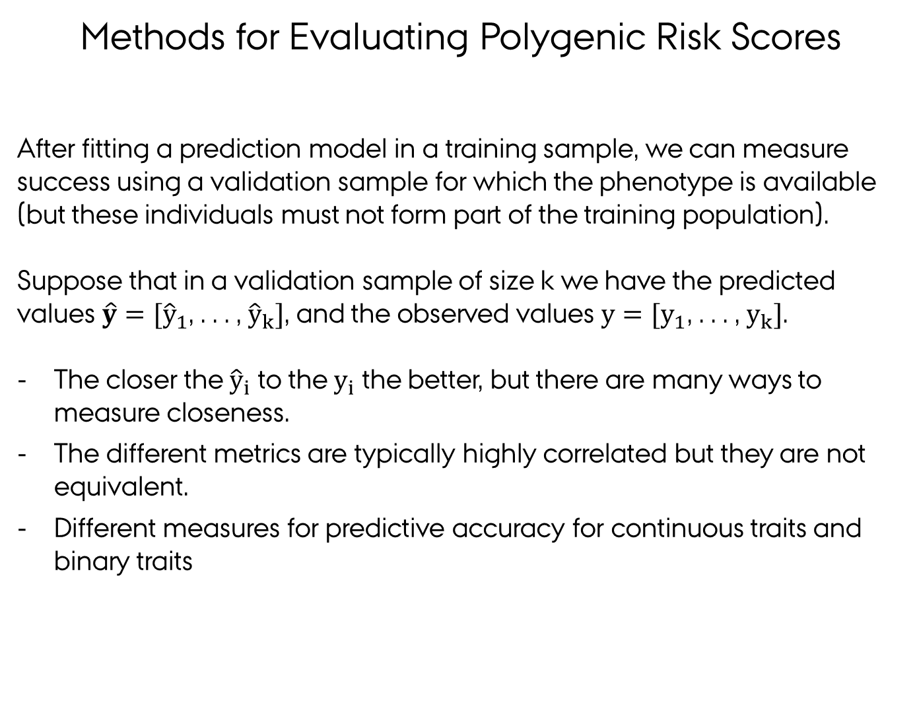
Methods for Evaluating Polygenic Risk Scores
After fitting a prediction model in a training sample, we can measure success using a validation sample for which the phenotype is available (but these individuals must not form part of the training population).
Suppose that in a validation sample of size k we have the predicted values ${\hat{y}=[\hat{y}}_{1}$, . . . , ${\hat{y}}_{k}]$, and the observed values ${y=[y}_{1}$, . . . , $y_{k}]$.
The closer the ${\hat{y}}_{i}$ to the $y_{i}$ the better, but there are many ways to measure closeness.
The different metrics are typically highly correlated but they are not equivalent.
Different measures for predictive accuracy for continuous traits and binary traits
Notes:
After fitting a prediction model in a training sample, we can measure success using a test sample for which the phenotype is available (but these individuals must not form part of the training population). If we don’t have a suitable test sample, we can artificially create one by holding back a fraction (say 0.1) from the training population; predictive accuracy then tends to be understated because the full training sample is not used to fit the model; conversely the test individuals are statistically the same as the training individuals, which may lead to an overstatement of predictive accuracy relative to future individuals with slightly different characteristics. Repeatedly estimating prediction accuracy by holding back a fraction of the training population is called cross-validation (CV). The held-back individuals may be resampled at random each time, or sampled systematically so that each individual is a member of the test sample a fixed number of times (typically once, called k-fold CV where 1/k is the fraction of individuals in each test sample).

Slide 39
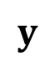
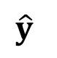
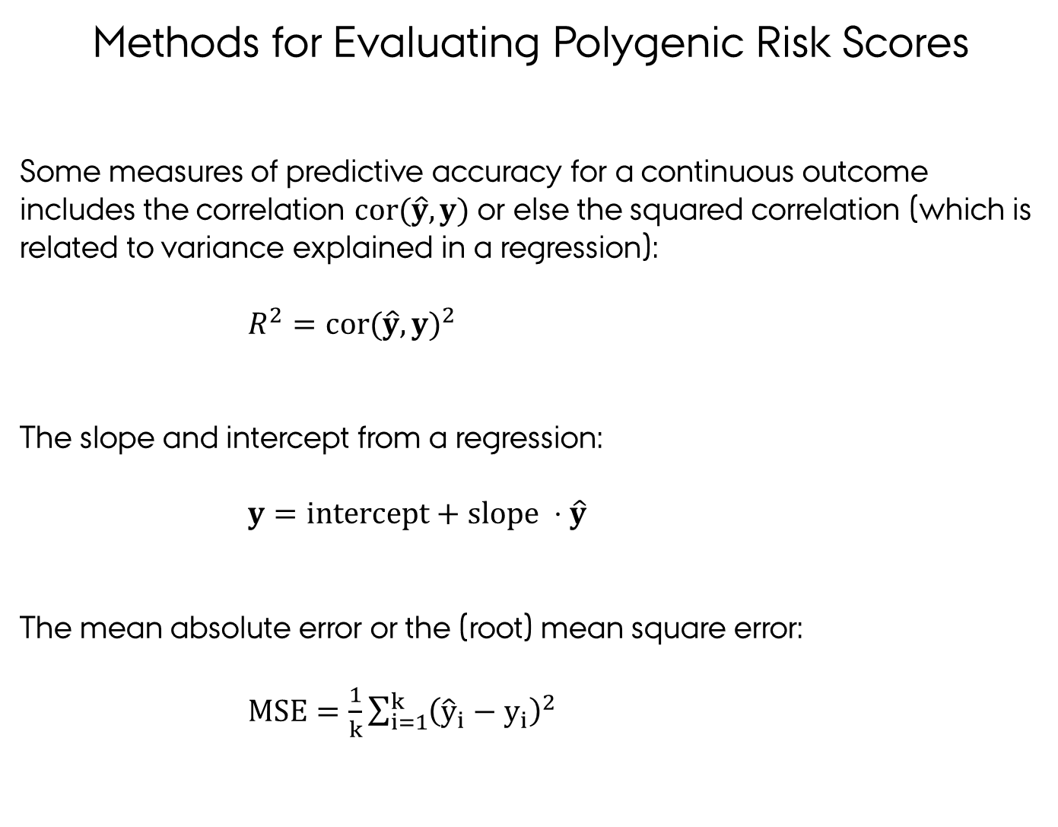
Methods for Evaluating Polygenic Risk Scores
Some measures of predictive accuracy for a continuous outcome includes the correlation $cor(\hat{y},y)$ or else the squared correlation (which is related to variance explained in a regression):
$R^{2}={cor(\hat{y},y)}^{2}$
The slope and intercept from a regression:
$y=intercept+slope ⋅\hat{y}$
The mean absolute error or the (root) mean square error:
$MSE=\frac{1}{k}\sum_{i=1}^{k}{{\left({\hat{y}}_{i}−y_{i}\right)}^{2}}$
$$y$$
$$\hat{y}$$
Notes:
After fitting a prediction model in a training sample, we can measure success using a test sample for which the phenotype is available (but these individuals must not form part of the training population). If we don’t have a suitable test sample, we can artificially create one by holding back a fraction (say 0.1) from the training population; predictive accuracy then tends to be understated because the full training sample is not used to fit the model; conversely the test individuals are statistically the same as the training individuals, which may lead to an overstatement of predictive accuracy relative to future individuals with slightly different characteristics. Repeatedly estimating prediction accuracy by holding back a fraction of the training population is called cross-validation (CV). The held-back individuals may be resampled at random each time, or sampled systematically so that each individual is a member of the test sample a fixed number of times (typically once, called k-fold CV where 1/k is the fraction of individuals in each test sample).

Slide 40
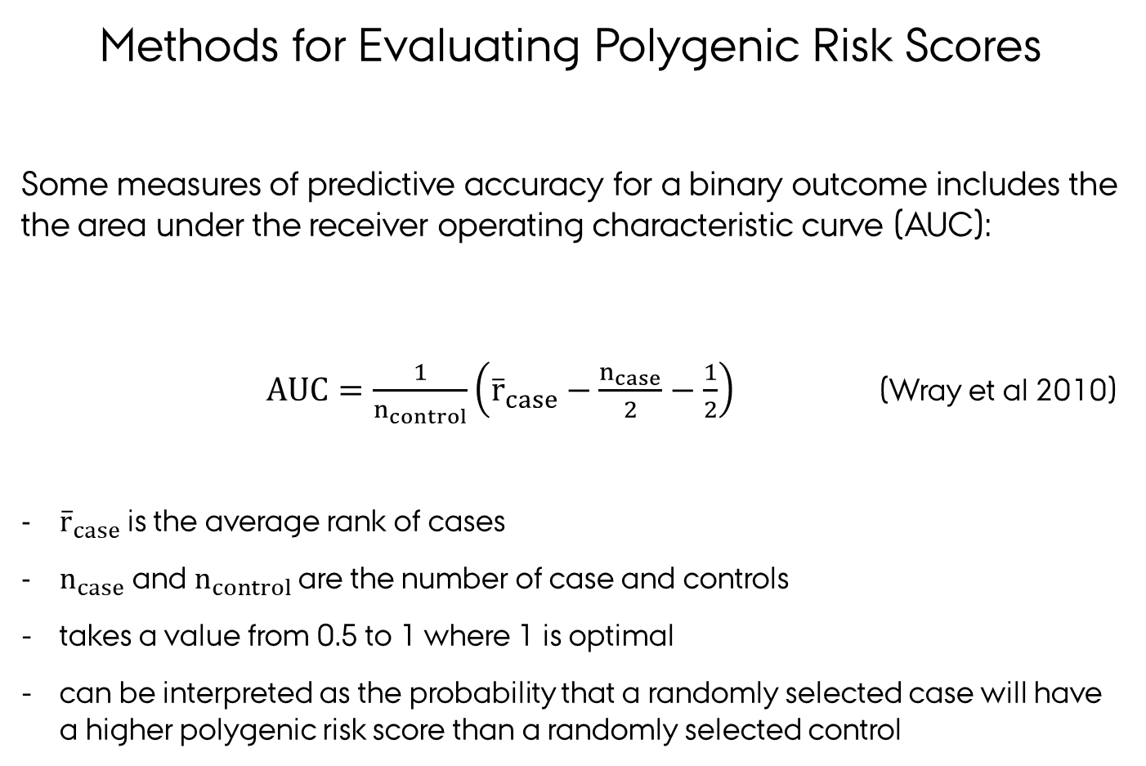
Methods for Evaluating Polygenic Risk Scores
Some measures of predictive accuracy for a binary outcome includes the the area under the receiver operating characteristic curve (AUC):
$AUC=\frac{1}{n_{control}}\left({\overline{r}}_{case}−\frac{n_{case}}{2}−\frac{1}{2}\right)$ (Wray et al 2010)
${\overline{r}}_{case}$ is the average rank of cases
$n_{case}$ and $n_{control}$ are the number of case and controls
takes a value from 0.5 to 1 where 1 is optimal
can be interpreted as the probability that a randomly selected case will have a higher polygenic risk score than a randomly selected control
Notes:
where LR is the likelihood ratio comparing two nested logistic regression models, $L_{0}$ is the log-likelihood of a model neglecting the GRS, and $n$ is the number of observations.

Slide 41
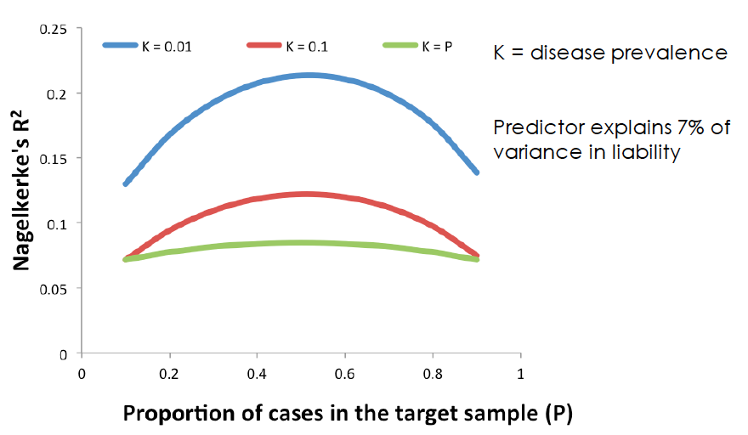
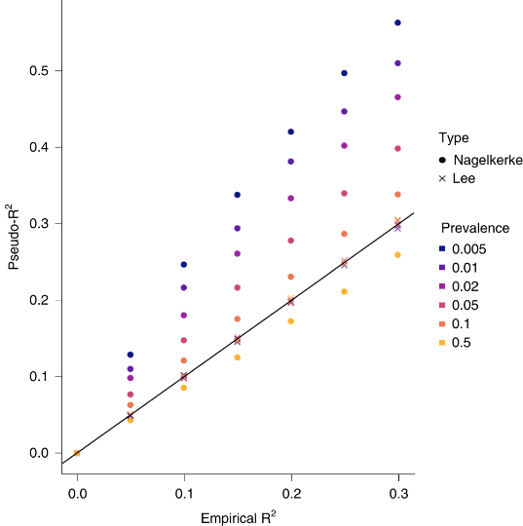
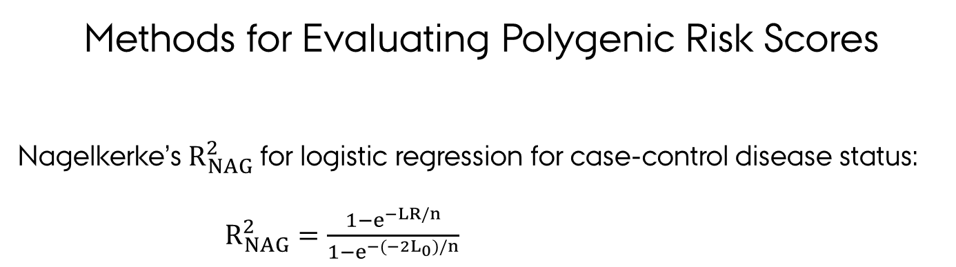
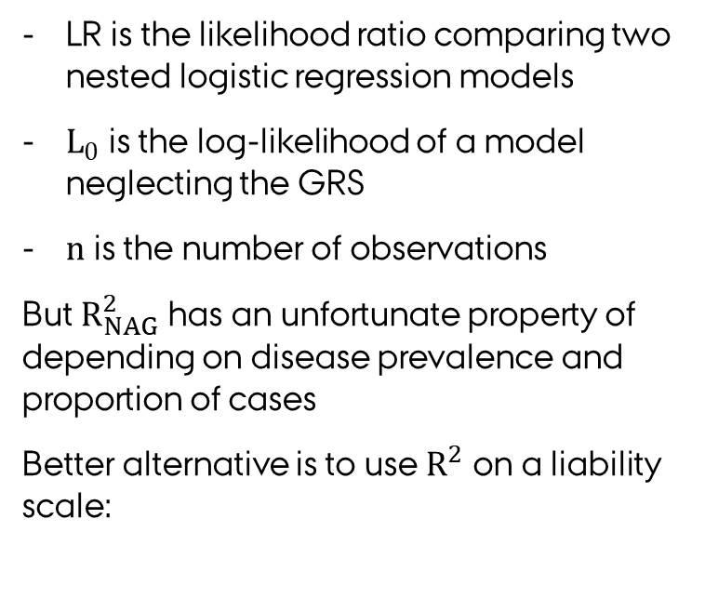
Methods for Evaluating Polygenic Risk Scores
Nagelkerke’s $R_{NAG}^{2}$ for logistic regression for case-control disease status:
$R_{NAG}^{2}=\frac{1−e^{−LR/n}}{1−e^{−(−2L_{0})/n}}$
LR is the likelihood ratio comparing two nested logistic regression models
$L_{0}$ is the log-likelihood of a model neglecting the GRS
$n$ is the number of observations
But $R_{NAG}^{2}$ has an unfortunate property of depending on disease prevalence and proportion of cases
Better alternative is to use $R^{2}$ on a liability scale:
Lee & Wray 2013, Wray et al. 2013, Choi et al. 2020)
Notes:
where LR is the likelihood ratio comparing two nested logistic regression models, $L_{0}$ is the log-likelihood of a model neglecting the GRS, and $n$ is the number of observations.

Slide 42
Methods for Evaluating Polygenic Risk Scores
The proportion of the population that has a k-fold increased odds (k = 2, 3, …), compared to the population disease risk.
Odds ratio of disease for an individual in the top PRS decile (or other quantiles) compared to individuals in a different part of the PRS distribution.
Notes:
After fitting a prediction model in a training sample, we can measure success using a test sample for which the phenotype is available (but these individuals must not form part of the training population). If we don’t have a suitable test sample, we can artificially create one by holding back a fraction (say 0.1) from the training population; predictive accuracy then tends to be understated because the full training sample is not used to fit the model; conversely the test individuals are statistically the same as the training individuals, which may lead to an overstatement of predictive accuracy relative to future individuals with slightly different characteristics. Repeatedly estimating prediction accuracy by holding back a fraction of the training population is called cross-validation (CV). The held-back individuals may be resampled at random each time, or sampled systematically so that each individual is a member of the test sample a fixed number of times (typically once, called k-fold CV where 1/k is the fraction of individuals in each test sample).

Slide 43
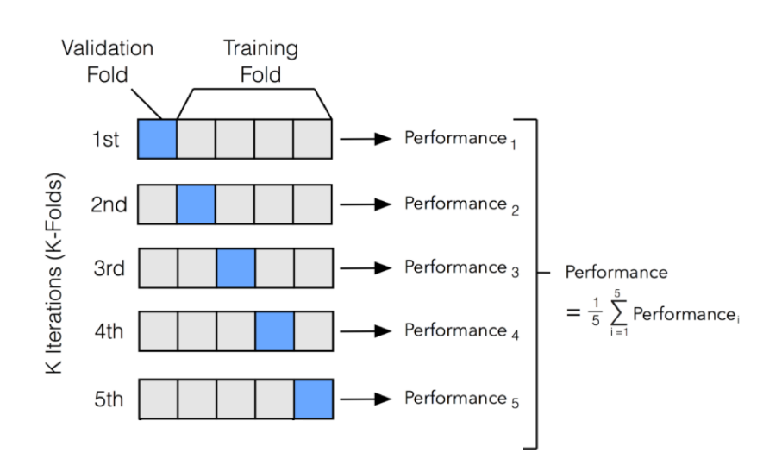
Methods for Evaluating Polygenic Risk Scores
Cross validation (CV) is a statistical procedure where prediction accuracy is estimated by holding back a fraction of the training population:
held-back individuals may be resampled at random each time, or sampled systematically so that each individual is a member of the test sample a fixed number of times (k-fold CV)
predictive accuracy then tends to be understated because the full training sample is not used to fit the model
individuals in validation and training populations must be independent otherwise prediction accuracy will be inflated
Notes:
After fitting a prediction model in a training sample, we can measure success using a test sample for which the phenotype is available (but these individuals must not form part of the training population). If we don’t have a suitable test sample, we can artificially create one by holding back a fraction (say 0.1) from the training population; predictive accuracy then tends to be understated because the full training sample is not used to fit the model; conversely the test individuals are statistically the same as the training individuals, which may lead to an overstatement of predictive accuracy relative to future individuals with slightly different characteristics. Repeatedly estimating prediction accuracy by holding back a fraction of the training population is called cross-validation (CV). The held-back individuals may be resampled at random each time, or sampled systematically so that each individual is a member of the test sample a fixed number of times (typically once, called k-fold CV where 1/k is the fraction of individuals in each test sample).

Slide 44
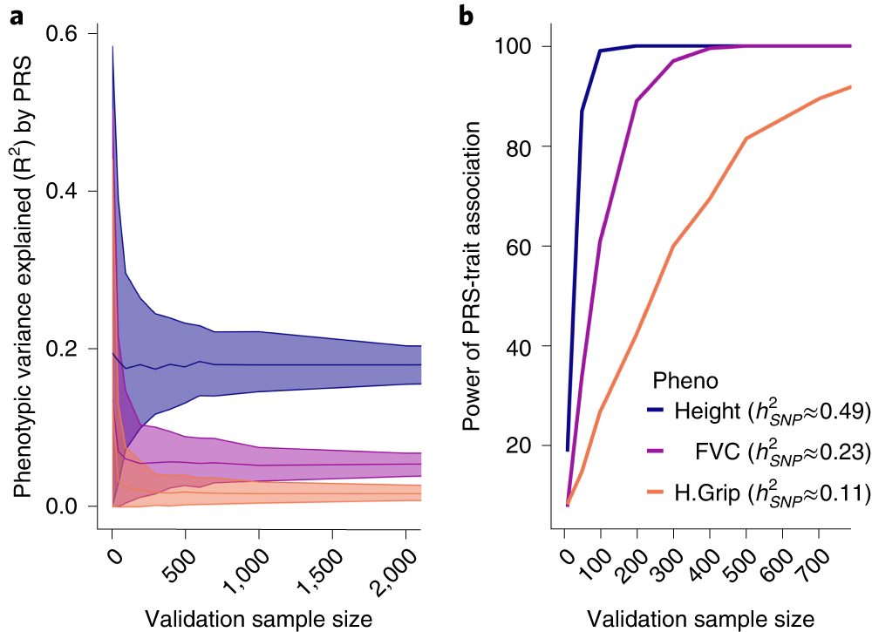
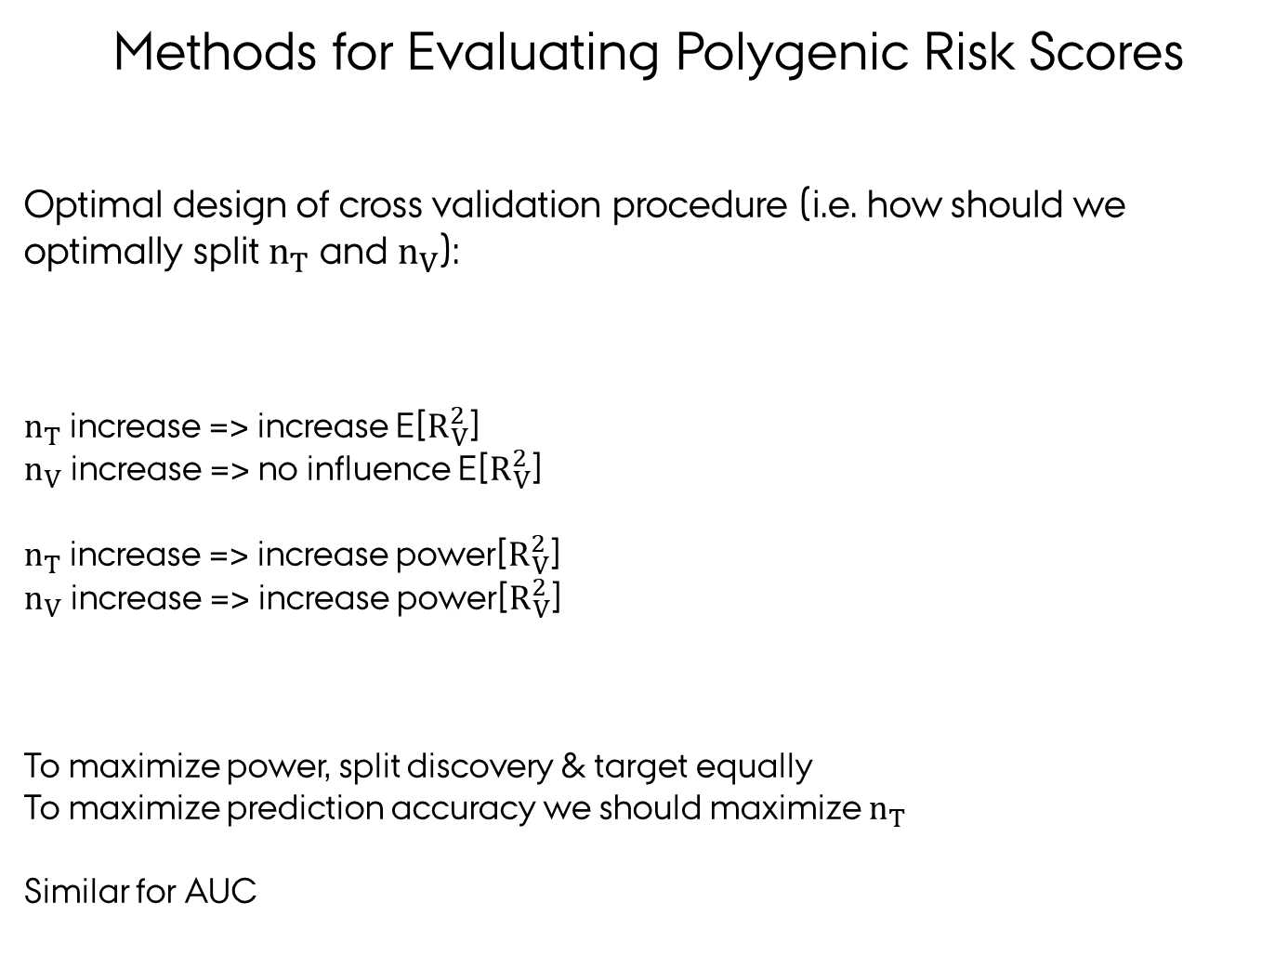
Methods for Evaluating Polygenic Risk Scores
Optimal design of cross validation procedure (i.e. how should we optimally split $n_{T}$ and $n_{V}$):
$n_{T}$ increase => increase E[$R_{V}^{2}$]
$n_{V}$ increase => no influence E[$R_{V}^{2}$]
$n_{T}$ increase => increase power[$R_{V}^{2}$]
$n_{V}$ increase => increase power[$R_{V}^{2}$]
To maximize power, split discovery & target equally
To maximize prediction accuracy we should maximize $n_{T}$
Similar for AUC
(Dudbridge 2013, Choi et al. 2020)
Notes:
After fitting a prediction model in a training sample, we can measure success using a test sample for which the phenotype is available (but these individuals must not form part of the training population). If we don’t have a suitable test sample, we can artificially create one by holding back a fraction (say 0.1) from the training population; predictive accuracy then tends to be understated because the full training sample is not used to fit the model; conversely the test individuals are statistically the same as the training individuals, which may lead to an overstatement of predictive accuracy relative to future individuals with slightly different characteristics. Repeatedly estimating prediction accuracy by holding back a fraction of the training population is called cross-validation (CV). The held-back individuals may be resampled at random each time, or sampled systematically so that each individual is a member of the test sample a fixed number of times (typically once, called k-fold CV where 1/k is the fraction of individuals in each test sample).

Slide 45
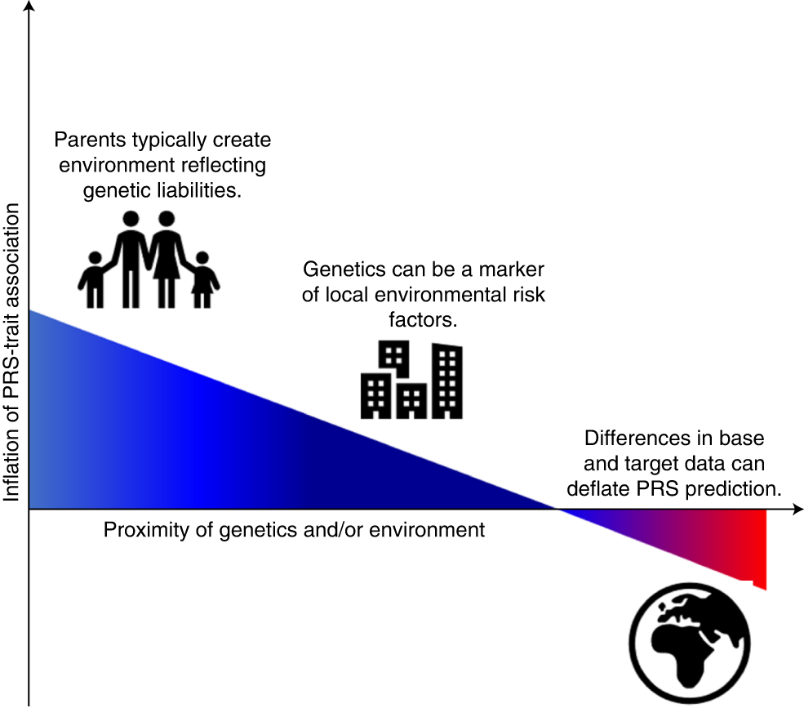
Methods for Evaluating Polygenic Risk Scores
Potential sources of biases in the evaluation of polygenic risk scores:
(Choi et al 2020)
Notes:
If the target data differ markedly from the base data in terms of allele frequencies, LD, the environment, selection pressures, etc., then the PRS-trait association will probably be deflated relative to a target sample that is well matched to the base data (note that relative inflation is theoretically possible if the trait has greater heritability in the target sample than the base sample58). Correlation between the population structure of genetics and the environment can inflate PRS-trait associations unless they are controlled for fully. This inflation can be exacerbated by a household effect in which parents produce an environment reflecting their genetic tendencies55, known as passive gene*environment correlation105. This figure illustrates in simple form some of the broad major influences on PRS-trait associations and their typical effects; it is not intended to capture the many nuances and exceptions involved or other important effects such as evocative or active genetic-environment correlations or assortative mating59,105.

Slide 46
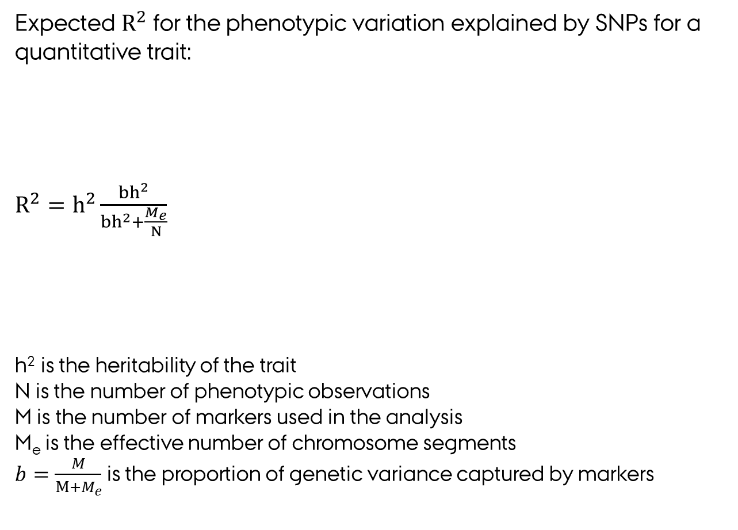
Methods for Evaluating Polygenic Risk Scores
Expected $R^{2}$ for the phenotypic variation explained by SNPs for a quantitative trait:
$R^{2}=h^{2}\frac{bh^{2}}{bh^{2}+\frac{M_{e}}{N}}$
h² is the heritability of the trait
N is the number of phenotypic observations
M is the number of markers used in the analysis
M_{e} is the effective number of chromosome segments
$b=\frac{M}{M+M_{e}}$ is the proportion of genetic variance captured by markers
(Lee et al. 2017a,
Lee et al. 2017b,
van Rheenen et al. 2019)
Notes:
Box 1: Quantifying phenotypic variation explained by SNPs
Quantitative traits
The proportion of phenotypic variance (R2) explained by a predictor of a quantitative trait formed using estimated effects of all markers depends on the number (M) of independently measured genomic variants (for example, single-nucleotide polymorphisms (SNPs)) associated with the trait, the proportion of the total variance they explain (h2M) and the sample size in the discovery sample (Nd)27,38,40. If all marker effects are assumed to come from the same normal distribution, then approximately
Disease traits
For disease traits, Nagelkerke's R2 (R2N) has been used in profile scoring analyses, following Purcell et al.29. R2N is an R2 measure in binary (0–1) outcome data and is usually applied in case–control validation samples, in which the proportion of cases is much higher than in the population. Alternatively, the area under the receiver operator curve (AUC) is reported73,74,75: this is a statistic with a long tradition of use in determining the efficacy of clinical predictors. AUC has the desirable property of being independent of the proportion of cases in the validation sample; one definition of AUC is that a randomly selected case is ranked higher by the predictor than a randomly selected control. A new statistic reflecting variance explained on the liability scale (R2l), which can be related to other statistics, such as R2N and AUC11, has been proposed76. Like any estimate on the liability scale, calculation of R2l requires specification of disease prevalence in the population but allows direct comparison of the variance explained by the predictor to estimates of heritability from family data and estimates of SNP heritability from genome-wide SNP data.

Slide 47
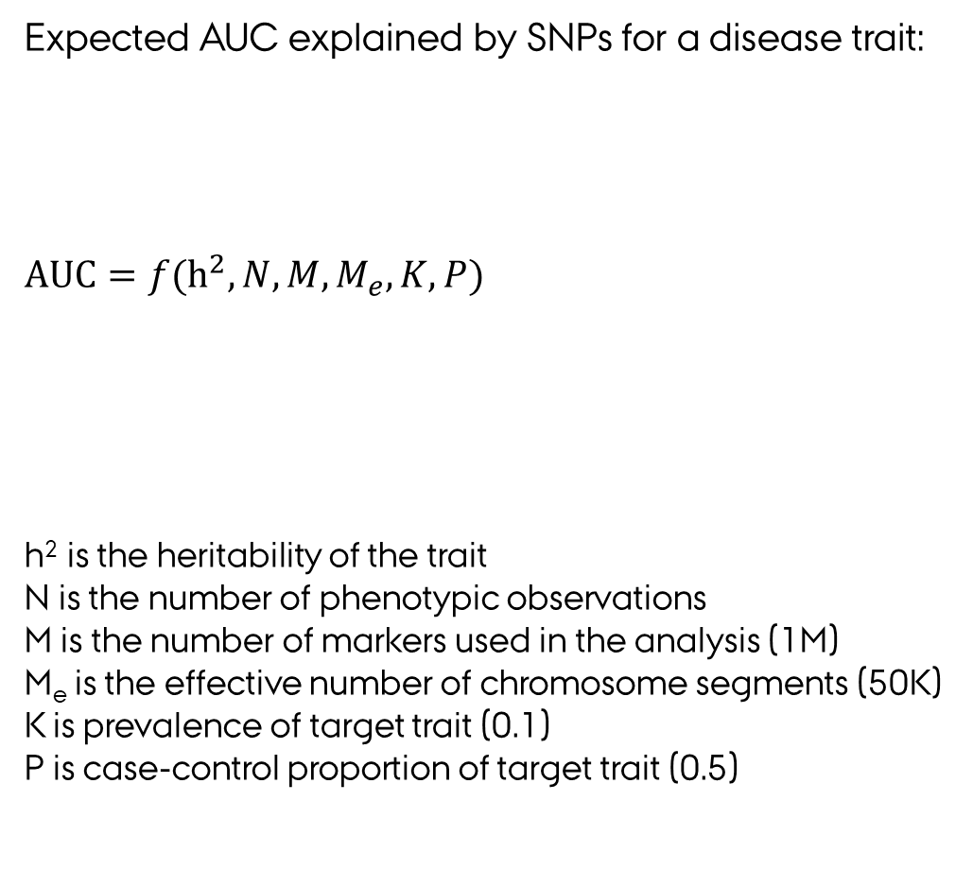
Methods for Evaluating Polygenic Risk Scores
Expected AUC explained by SNPs for a disease trait:
$AUC={f(h}^{2},N,M,M_{e},K,P)$
h² is the heritability of the trait
N is the number of phenotypic observations
M is the number of markers used in the analysis (1M)
M_{e} is the effective number of chromosome segments (50K)
K is prevalence of target trait (0.1)
P is case-control proportion of target trait (0.5)
(Lee et al. 2017a,
Lee et al. 2017b,
van Rheenen et al. 2019)
Notes:
Box 1: Quantifying phenotypic variation explained by SNPs
Quantitative traits
The proportion of phenotypic variance (R2) explained by a predictor of a quantitative trait formed using estimated effects of all markers depends on the number (M) of independently measured genomic variants (for example, single-nucleotide polymorphisms (SNPs)) associated with the trait, the proportion of the total variance they explain (h2M) and the sample size in the discovery sample (Nd)27,38,40. If all marker effects are assumed to come from the same normal distribution, then approximately
Disease traits
For disease traits, Nagelkerke's R2 (R2N) has been used in profile scoring analyses, following Purcell et al.29. R2N is an R2 measure in binary (0–1) outcome data and is usually applied in case–control validation samples, in which the proportion of cases is much higher than in the population. Alternatively, the area under the receiver operator curve (AUC) is reported73,74,75: this is a statistic with a long tradition of use in determining the efficacy of clinical predictors. AUC has the desirable property of being independent of the proportion of cases in the validation sample; one definition of AUC is that a randomly selected case is ranked higher by the predictor than a randomly selected control. A new statistic reflecting variance explained on the liability scale (R2l), which can be related to other statistics, such as R2N and AUC11, has been proposed76. Like any estimate on the liability scale, calculation of R2l requires specification of disease prevalence in the population but allows direct comparison of the variance explained by the predictor to estimates of heritability from family data and estimates of SNP heritability from genome-wide SNP data.

Slide 48
Outline
Introduction to Polygenic Risk Scoring
Data used for Polygenic Risk Scores
Training/Validation
Individidual level or summary statistic data
Methods for Computing Polygenic Risk Scores
Standard approach based on LD pruning and thresholding (P+T)
Bayesion approach using shrinkage estimation (e.g. Ldpred, BayesR)
Multiple trait approaches
Methods for Evaluating Polygenic Risk Scores
Population or individual level measures
Quantitative and binary traits
Expected accuracies
Clinical Utility of Polygenic Risk Scores
Notes:
The genetic risk is quantified using a genetic risk score combines information from large numbers of markers across the genome (hundreds to millions) to give a single numerical score for individual’s risk for developing a disease:
For a particular disease or trait a polygenic risk score​ is constructed as weighted average of the genotypes as shown in the matemathical expression on this slide
The polygenic risk score tend to be normally distributed as shown in the figure to the right and using this score we can identify individuals in the extreme tails of the distribution with high or low genetic risk
We can also rank individuals according to their risk score and compare that to their observed disease profile.
A polygenic risk score is a good predictor if the relationship between predicted risk and observed disease status is S-shaped as shown in the figure to the left

Slide 49
Clinical Utility of Polygenic Risk Scores
Precision health account for differences in people’s genes, environments and lifestyles and formulates treatment and prevention strategies based on patients’ unique backgrounds and conditions:
Aims to predict disease risk or response to medical treatment based on an individual’s DNA profile (or other types of biomarkers) and other risk factors
Potential to improve decision-making in health care systems which could improve patient health and lower health care costs
It is not a new concept, but growing amounts of genetic and health care data and development of sophisticated analytical tools are bringing it closer to the clinics
Because we inherit our unique pattern of DNA variation at birth, genetics (e.g. polygenic risk scoring) has a special role to play in disease risk prediction and in patient stratification for medical treatment.
Notes:
Precision health account for differences in people’s genes, environments and lifestyles and formulates treatment and prevention strategies based on patients’ unique backgrounds and conditions:
PH aims to predict disease risk or response to medical treatment based on an individual’s DNA profile and other risk factors
It has the potential to improve decision-making in healthcare systems which could improve patient health and lower health care costs
It is not a new concept, but growing amounts of genetic and health care data and development of sophisticated analytical tools are bringing it closer to the clinics
Today I will present some highlights from a case study where we have developed an integrated polygenic and clinical risk tool that enhances coronary artery disease prediction
It is work that I have done at Genomicsplc and it has recently been accepted for publication in Circulation

Slide 50
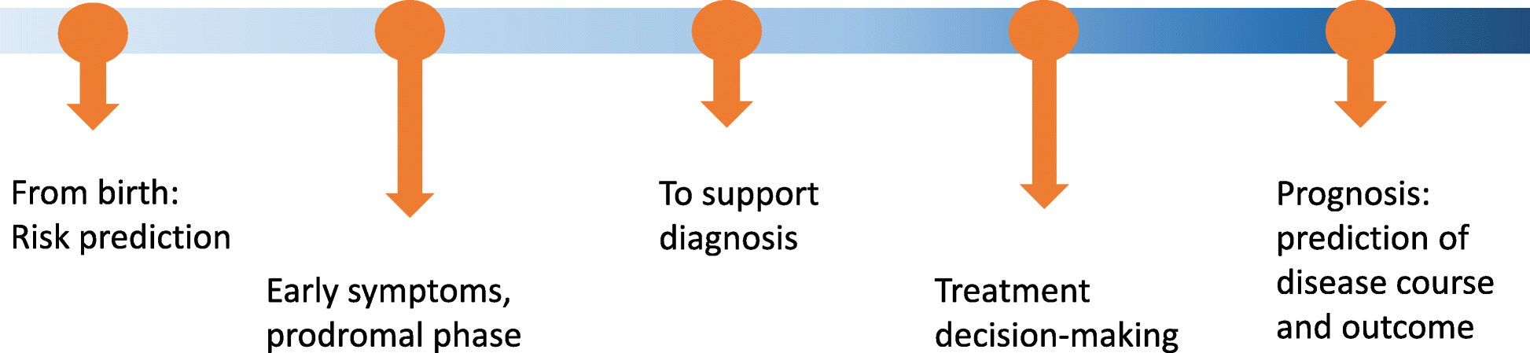
Clinical Utility of Polygenic Risk Scores
Lifeline of the potential relevance of polygenic risk scores showing points through disease trajectory where polygenic risk scores have the potential to impact clinical care:
As PRS remains constant over the life course it could be used to guide disease prevention earlier in life before standard risk factors have an appreciable impact
Given the plummeting costs of genetic tests current disease risk prediction tools could be enhanced with the addition of polygenic risks
(Lewis & Vassos. 2020)
Notes:
The genetic risk is quantified using a genetic risk score combines information from large numbers of markers across the genome (hundreds to millions) to give a single numerical score for individual’s risk for developing a disease:
For a particular disease or trait a polygenic risk score​ is constructed as weighted average of the genotypes as shown in the matemathical expression on this slide
The polygenic risk score tend to be normally distributed as shown in the figure to the right and using this score we can identify individuals in the extreme tails of the distribution with high or low genetic risk
We can also rank individuals according to their risk score and compare that to their observed disease profile.
A polygenic risk score is a good predictor if the relationship between predicted risk and observed disease status is S-shaped as shown in the figure to the left

Slide 51
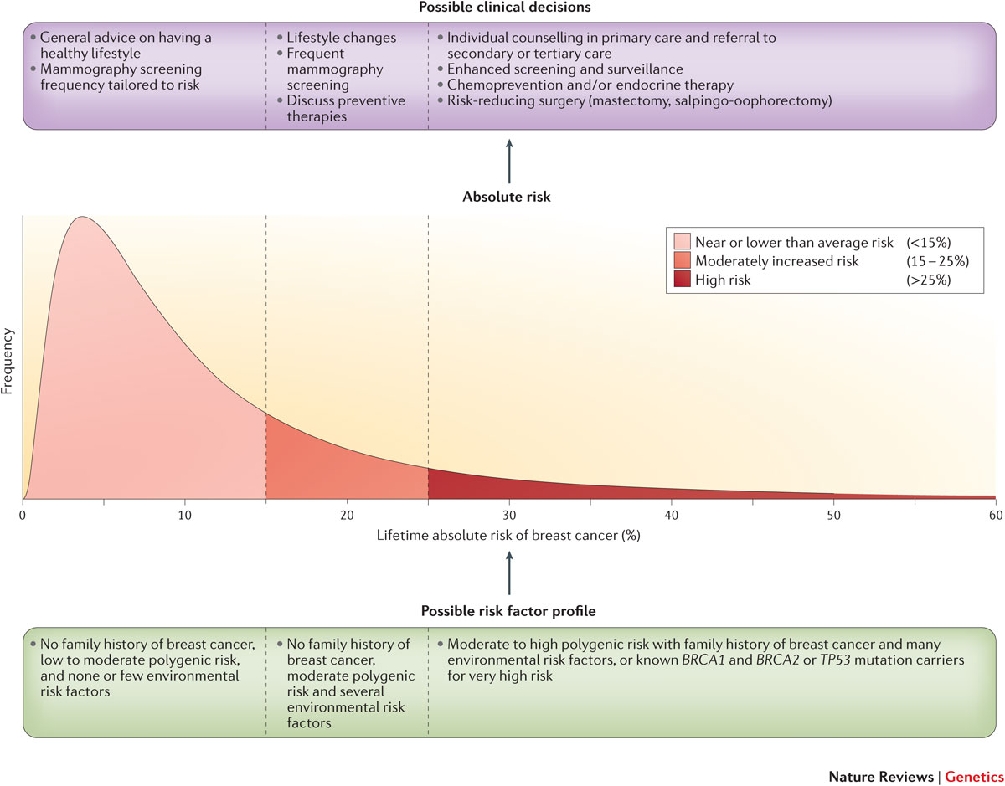
Clinical Utility of Polygenic risk Scores
(Chatterjee et al. 2016)
Notes:
The genetic risk is quantified using a genetic risk score combines information from large numbers of markers across the genome (hundreds to millions) to give a single numerical score for individual’s risk for developing a disease:
For a particular disease or trait a polygenic risk score​ is constructed as weighted average of the genotypes as shown in the matemathical expression on this slide
The polygenic risk score tend to be normally distributed as shown in the figure to the right and using this score we can identify individuals in the extreme tails of the distribution with high or low genetic risk
We can also rank individuals according to their risk score and compare that to their observed disease profile.
A polygenic risk score is a good predictor if the relationship between predicted risk and observed disease status is S-shaped as shown in the figure to the left

Slide 52
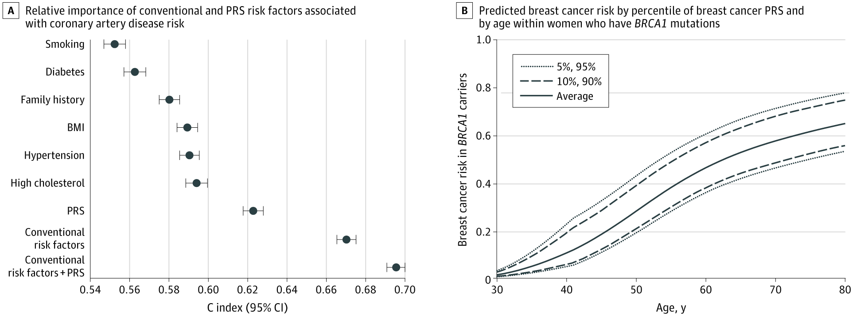
Clinical Utility of Polygenic Risk Scores
Relative importance of conventional and polygenic risk scores:
(Wray et al 2021)
Notes:
A, Relative importance of conventional and PRS risk factors associated with coronary artery disease risk.26 The y-axis can be interpreted as the probability that a person who went on to have coronary artery disease ranked higher on the risk predictor than someone who did not get the disease. Results from Cox regression of incident coronary artery disease in the UK Biobank for conventional risk factors individually and in combination with the PRS, including covariates (sex-stratiﬁed age-as-timescale). B, Predicted breast cancer risk by percentile of breast cancer PRS and by age within women who have BRCA1 mutations.27 See the eAppendix in the Supplement for more detail.

Slide 53
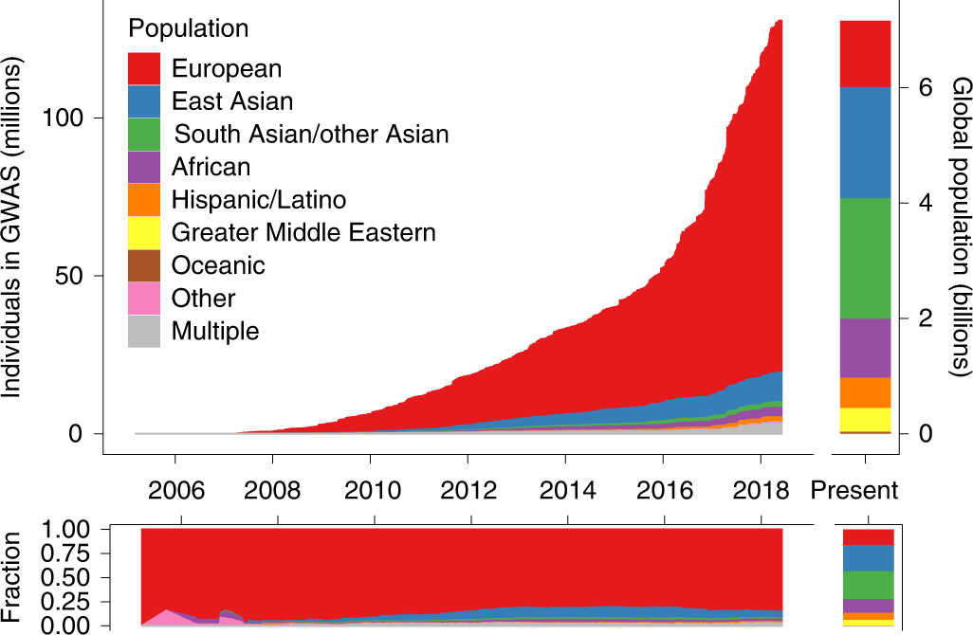
Clinical Utility of Polygenic Risk Scores
Ancestry of GWAS participants over time, as compared with the global population:
(Martin et al 2019)
Notes:
Cumulative data, as reported by the GWAS catalog⁷⁶. Individuals whose ancestry is ‘not reported’ are not shown.

Slide 54
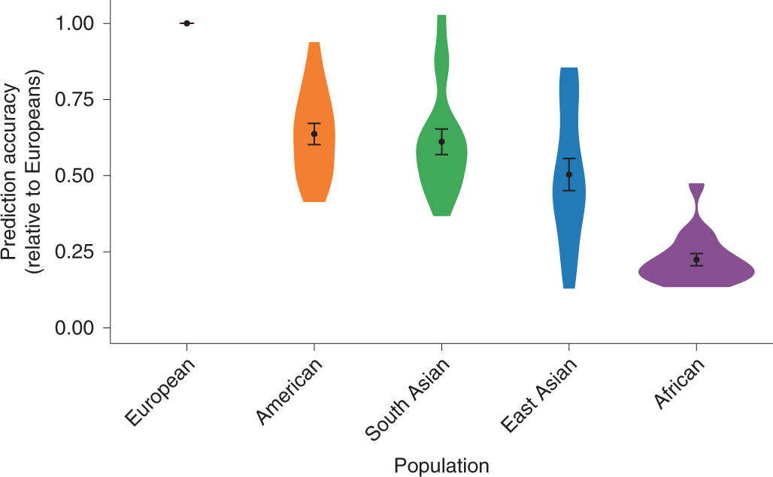
Clinical Utility of Polygenic Risk Scores
Prediction accuracy relative to European-ancestry individuals across 17 quantitative traits and 5 continental populations in the UKBB:
(Martin et al 2019)
Notes:
All phenotypes shown here are quantitative anthropometric and blood-panel traits, as described in Supplementary Table 6, which includes discovery-cohort sample sizes. Prediction target individuals do not overlap with the discovery cohort and are unrelated; sample sizes are shown in Supplementary Table 7. Violin plots show distributions of relative prediction accuracies, points show mean values, and error bars show s.e.m. values. Prediction R² for each trait and population are shown in Supplementary Fig. 12.

Slide 55
Summary
Introduction to Polygenic Risk Scoring
Data used for Polygenic Risk Scores
Training/Validation
Individidual level or summary statistic data
Methods for Computing Polygenic Risk Scores
Standard approach based on LD pruning and thresholding (P+T)
Bayesion approach using shrinkage estimation (e.g. Ldpred, BayesR)
Multiple trait approaches
Methods for Evaluating Polygenic Risk Scores
Population or individual level measures
Quantitative and binary traits
Expected accuracies
Clinical Utility of Polygenic Risk Scores
Notes:
The genetic risk is quantified using a genetic risk score combines information from large numbers of markers across the genome (hundreds to millions) to give a single numerical score for individual’s risk for developing a disease:
For a particular disease or trait a polygenic risk score​ is constructed as weighted average of the genotypes as shown in the matemathical expression on this slide
The polygenic risk score tend to be normally distributed as shown in the figure to the right and using this score we can identify individuals in the extreme tails of the distribution with high or low genetic risk
We can also rank individuals according to their risk score and compare that to their observed disease profile.
A polygenic risk score is a good predictor if the relationship between predicted risk and observed disease status is S-shaped as shown in the figure to the left

Slide 56
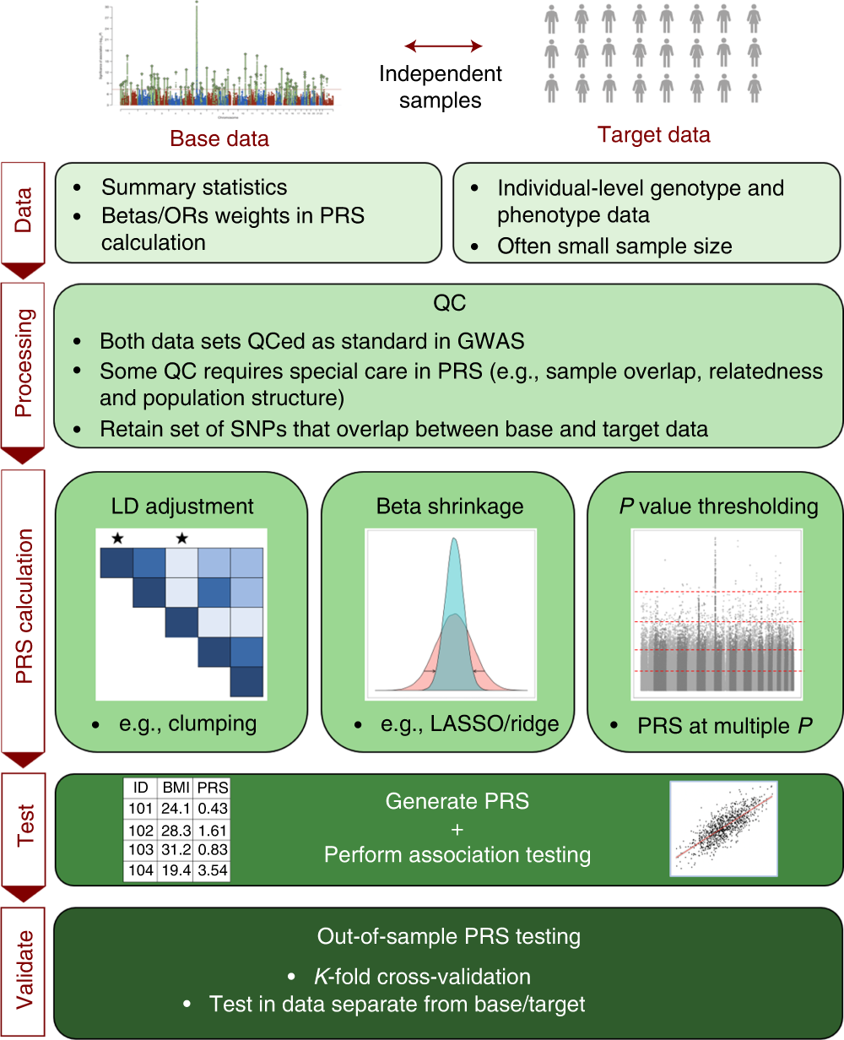
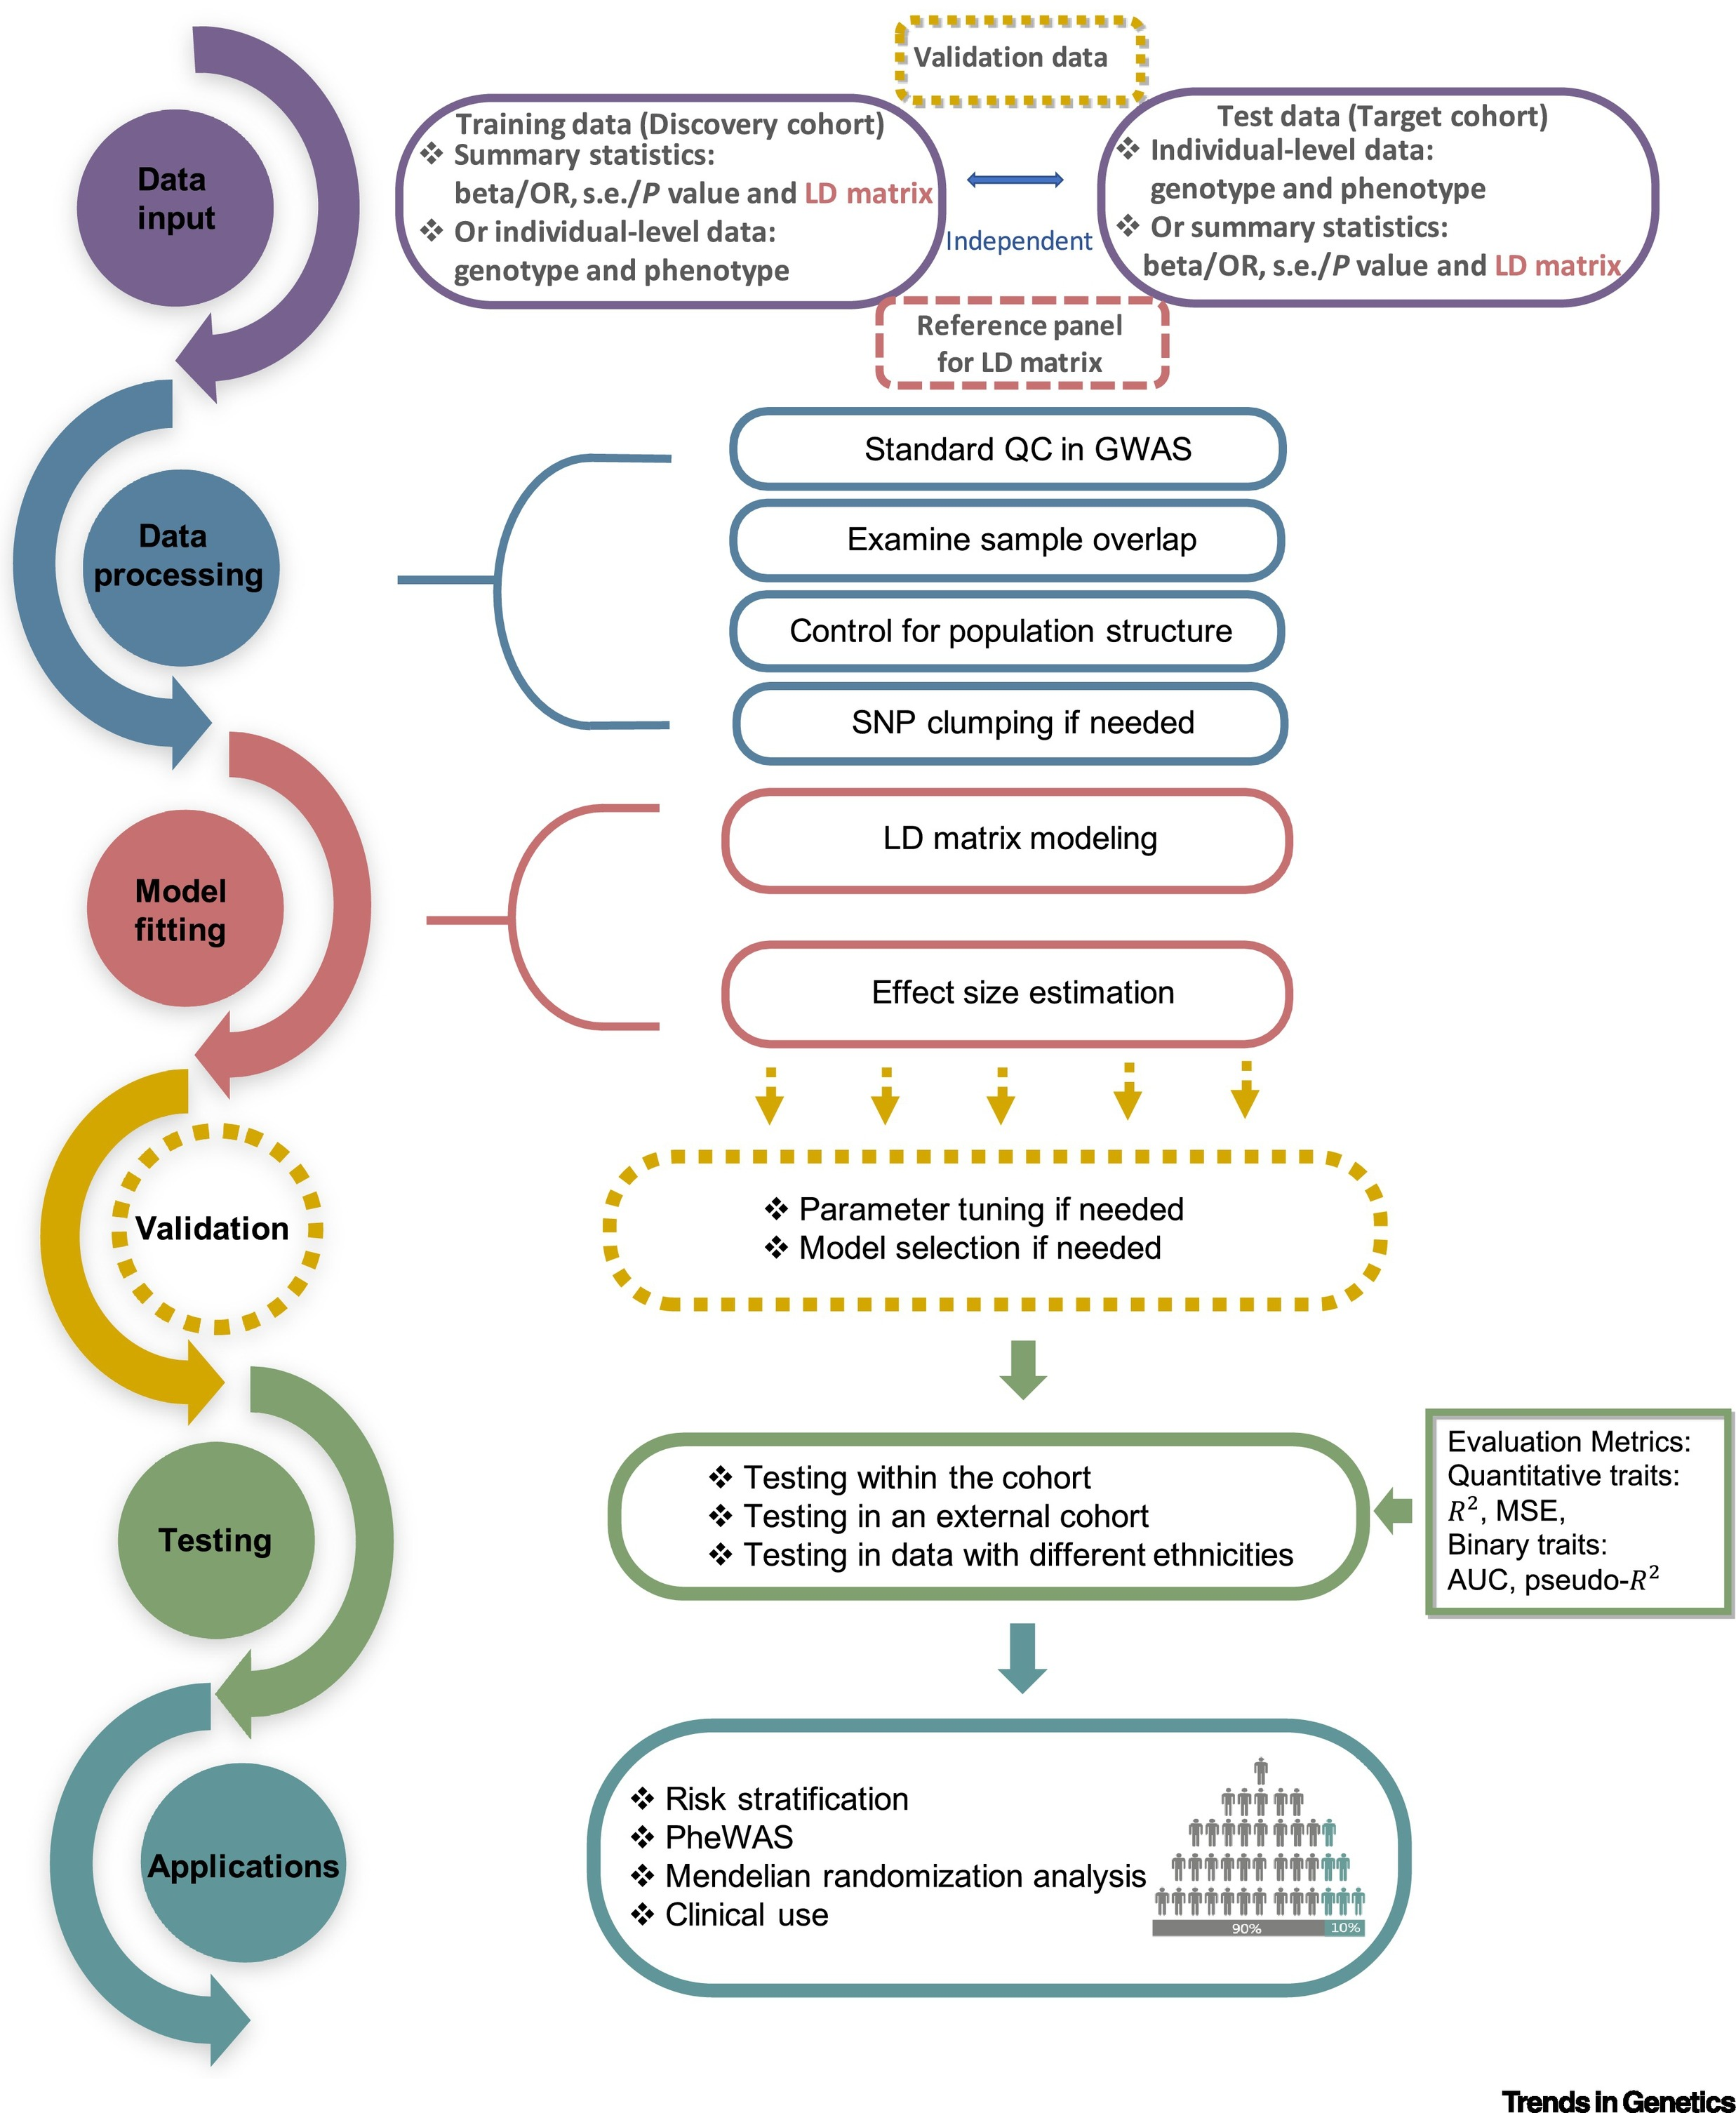
Introduction Polygenic Risk Scoring
(Choi et al 2020)
(Ma & Zhou 2021)
Notes:
PRS analyses can be characterized by their use of base and target data sets. QC of both data sets is described in ‘QC of base and target data’, while the different approaches to calculating PRSs (e.g., LD adjustment via clumping, beta shrinkage using LASSO regression or P value thresholding) are summarized in ‘Calculation of PRSs’. Issues relating to utilizing PRSs for association analyses to test hypotheses, including interpretation of results and avoidance of overfitting to the target data, are detailed in ‘Interpretation and presentation of results’.

Slide 57
References
Dudbridge 2013: 10.1371/journal.pgen.1003348
Daetwyler et al. 2008: 10.1371/journal.pone.0003395
Lee et al. 2017: 10.1371/journal.pone.0189775
Lee & Wray 2013: 10.1371/journal.pone.0071494
de los Campos et al. 2013: 10.1534/genetics.112.143313
Cheng et al. 2018: 10.1534/genetics.118.300650
Wray et al. 2010: 10.1371/journal.pgen.1000864
Martin et al. 2020: 10.1038/s41588-019-0379-x
Riveros-Mckay et al. 2021: 10.1161/CIRCGEN.120.003304
Wray et al 2013: 10.1038/nrg3457
van Rheenen et al 2019: 10.1038/s41576-019-0137-z
Lloyd et al. 2019: 10.1038/s41467-019-12653-0
Vilhjalmson 2015: 10.1016/j.ajhg.2015.09.001
Sørensen et al. 2015 10.1093/genetics/201.2.NP
Rohde et al. 2020 10.1093/bioinformatics/btz955
Rohde et a.l 2021 10.3389/fmed.2021.711208
Maier et al. 2018: 10.1038/s41467-017-02769-6
Ma & Zhou 2021: 10.1038/s41467-017-02769-6
Choi et al. 2020: 10.1038/s41596-020-0353-1
Wray et al. 2021: 10.1001/jamapsychiatry.2020.3049

Slide 58
R package qgg
(psoerensen.github.io/qgg/)
qgg provides an infrastructure for efficient processing of large-scale genetic and phenotypic data including core functions for:
BLUP/REML/BLR methods
fitting linear (mixed) models
estimating genetic parameters (heritability and correlation)
genomic prediction (polygenic risk scoring)
single marker association analysis
gene set enrichment analysis
qgg handles large-scale data by taking advantage of:
fast and memory efficient algorithms implemented using C++
multi-core processing using openMP
multithreaded matrix operations implemented in BLAS libraries (e.g. OpenBLAS, ATLAS or MKL)
batch processing of genotype data stored in binary files (e.g. PLINK bedfiles)
Notes:
Precision health account for differences in people’s genes, environments and lifestyles and formulates treatment and prevention strategies based on patients’ unique backgrounds and conditions:
PH aims to predict disease risk or response to medical treatment based on an individual’s DNA profile and other risk factors
It has the potential to improve decision-making in healthcare systems which could improve patient health and lower health care costs
It is not a new concept, but growing amounts of genetic and health care data and development of sophisticated analytical tools are bringing it closer to the clinics
Today I will present some highlights from a case study where we have developed an integrated polygenic and clinical risk tool that enhances coronary artery disease prediction
It is work that I have done at Genomicsplc and it has recently been accepted for publication in Circulation

Slide 59
?

